Slide 1
LSST Variable Star Classification
Tanner Leighton

Slide 2
Perhaps most important thing from this slideshow…
This ppt details a lot of work I did summer 2017. Later in the ppt, I include many light curves, many of which may want to be used for zooniverse project (not this LC but the found source), so I have detailed above each LC information about it that will enable one to ‘re-find’ it!
The way I did this (in general): star#.tbl – RA DEC coordinate – period – where I found it
Here is a specific example: lyrae9.tbl – 20 48 14.9 +00 07 05 – period: 0.5851614753091116 – http://vizier.cfa.harvard.edu/viz-bin/VizieR-3?-source=J/MNRAS/398/1757/lyraes

Slide 3
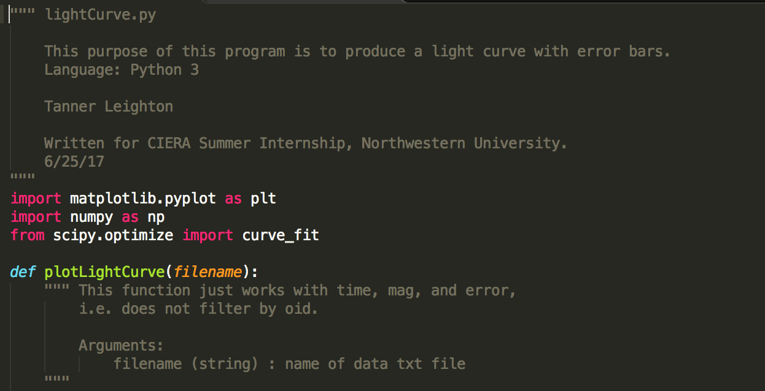
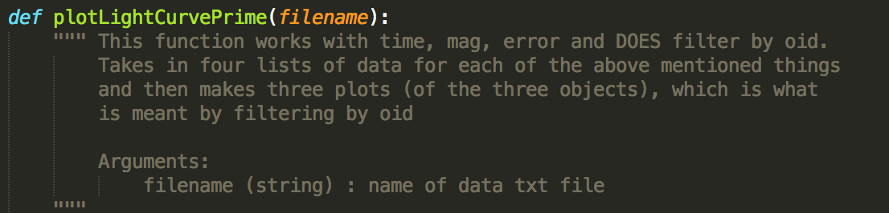
Week 1:

Slide 4
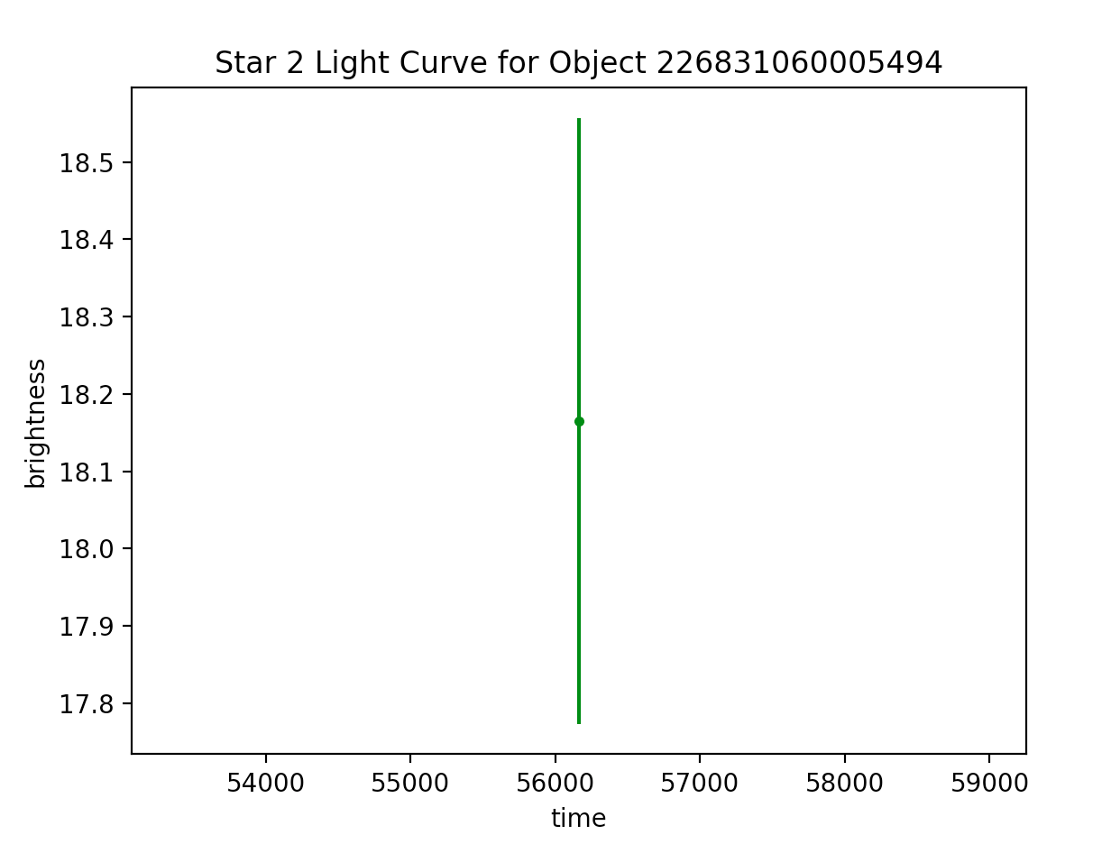
Light curves for star 2 (not phase-folded. Not yet. In time) (RA = 20:50:00.91, dec = -00:42:23.8) (separate plots for different oid’s)
Week 1:

Slide 5
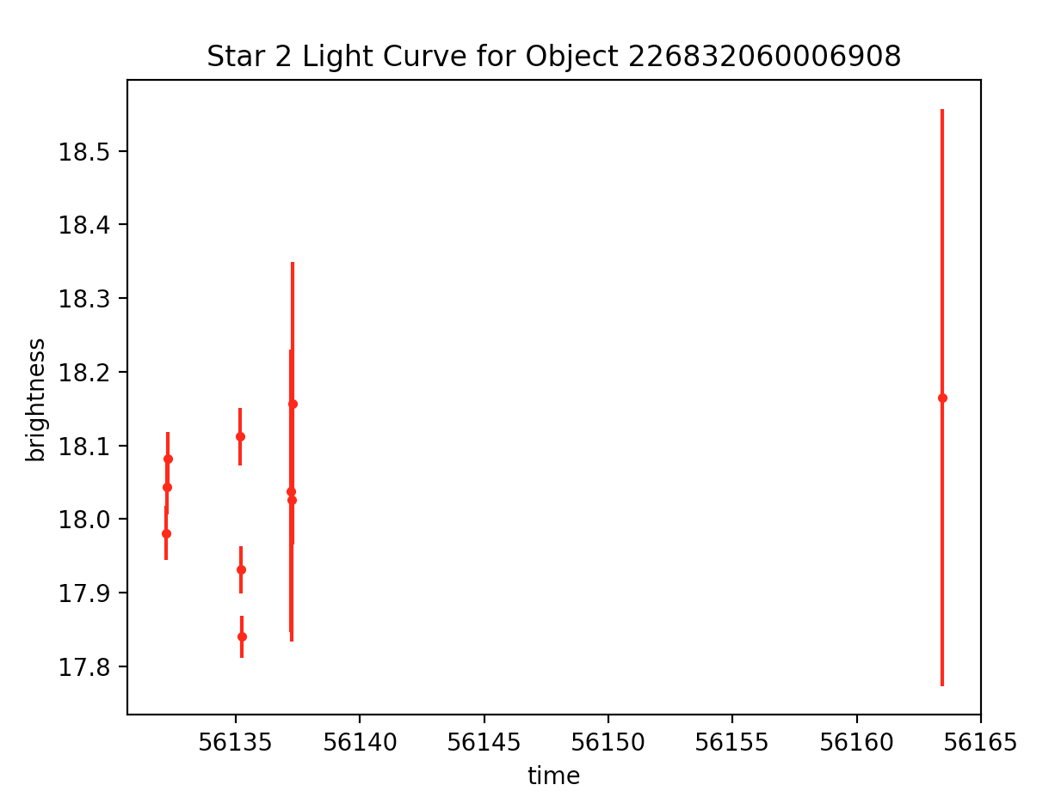
Light curves for star 2 cont. for object 226832060006908, best-fit period = 0.191486
Week 1:

Slide 6
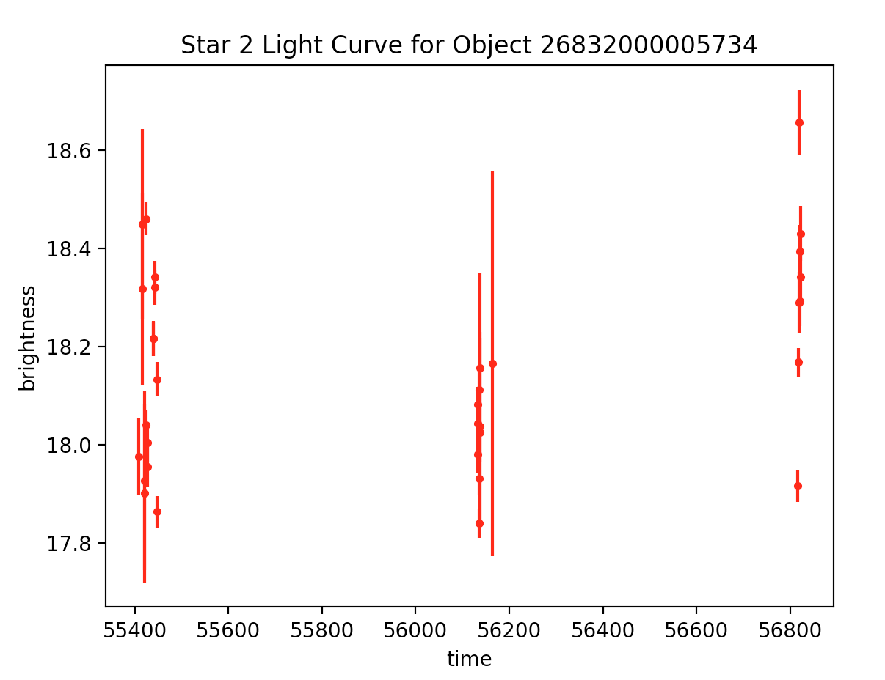
Light curves for star 2 cont. for object 26832000005734, best-fit period = 2.440220
Week 1:

Slide 7
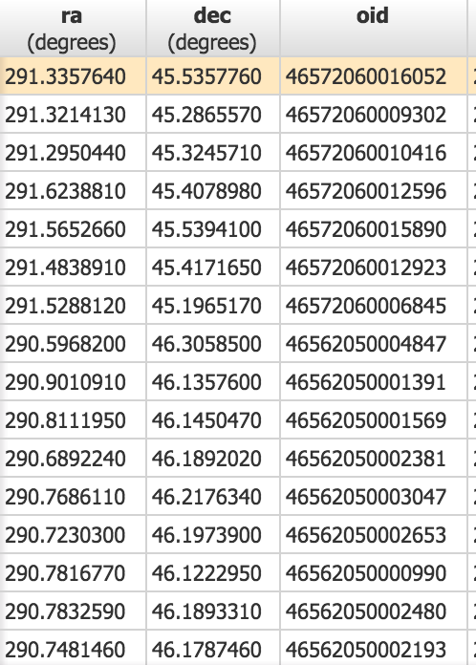
Week 2:
First ran a query on the PTF Objects table to return sources with bestChiSQ > 100 and nbestobs > 100. Selected one of those sources to download the light curve data for that source from the Lightcurve table.
This was the third star I have worked with.
For this task, I had to augment my light curve plotting software.
Query of first few listings…

Slide 8
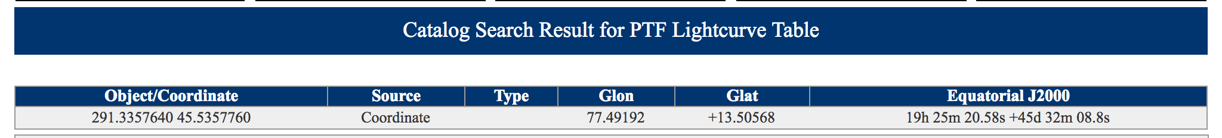
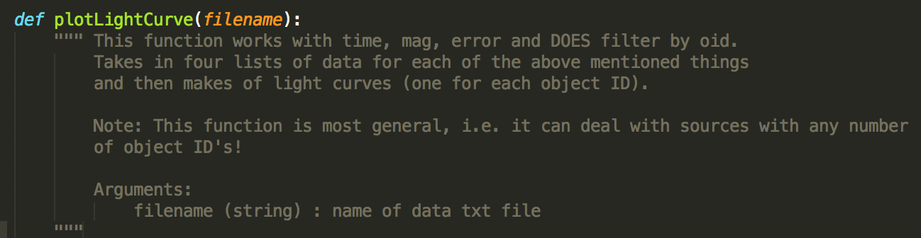
Star 3
Week 2:
As I have plotted more and more lightcurves, I have made my plotting software more and more general (it worked perfectly fine for the first two stars not being completely general). However, there are sources with only one object id and others with >3, so I took the time when generalizing the code to work for star 3 to be completely generalize (to work for star 3 or any star!). Now, the code can handle sources with any number of OID’s.

Slide 9
Histogram of Magnitudes
Week 2:
Next I went to object table (on Caltech IRSA website) and did a query for all sources with bestchiSQ > 10 and ngoodobs > 250.
Downloaded the results of that table
Made a histogram plot of the magnitudes

Slide 10
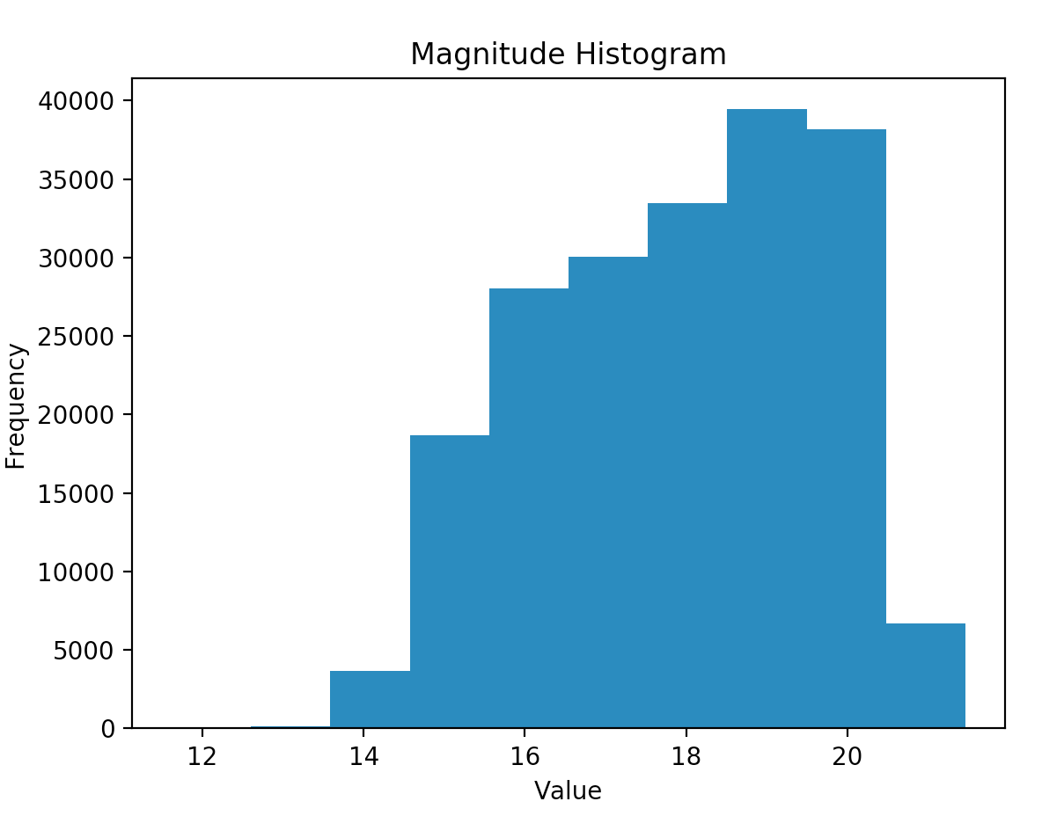
Week 2:

Slide 11
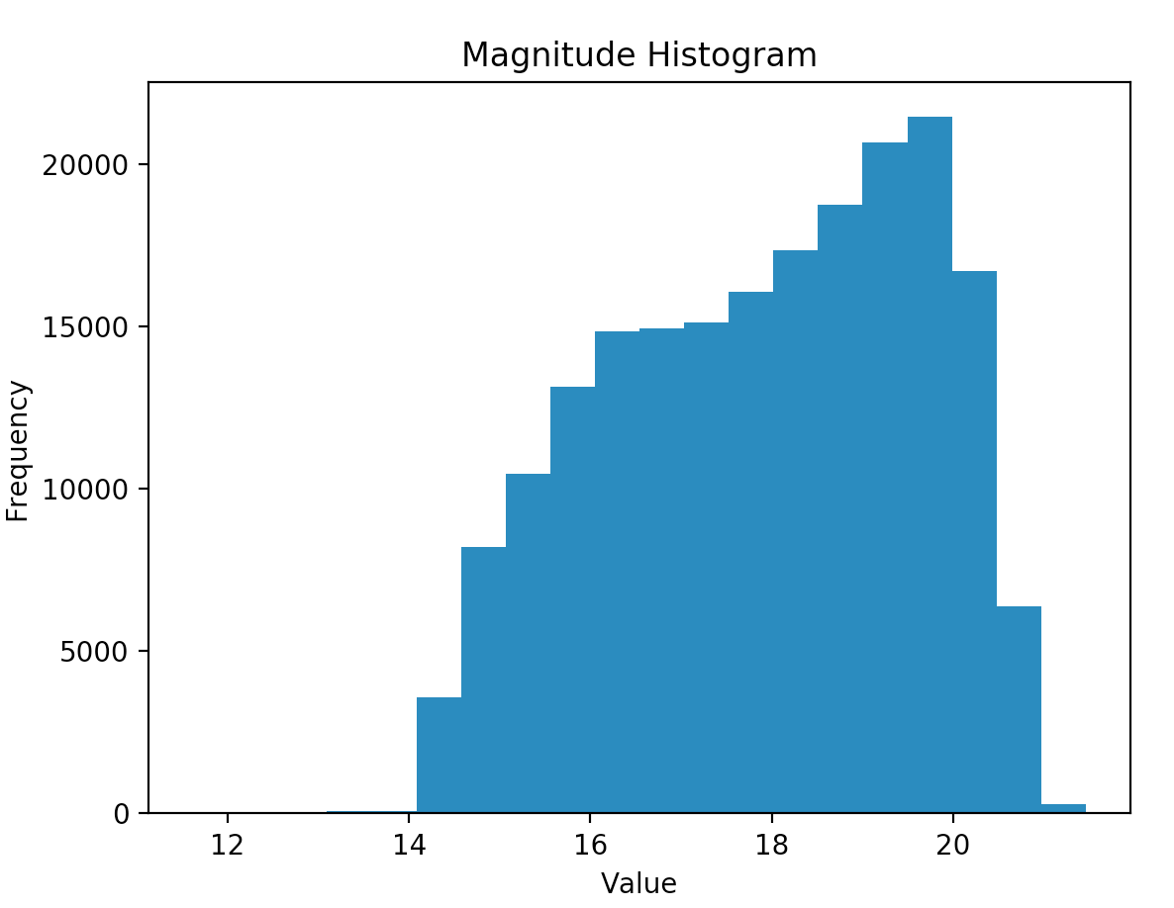
*Week 3 Update: More bins!*

Slide 12
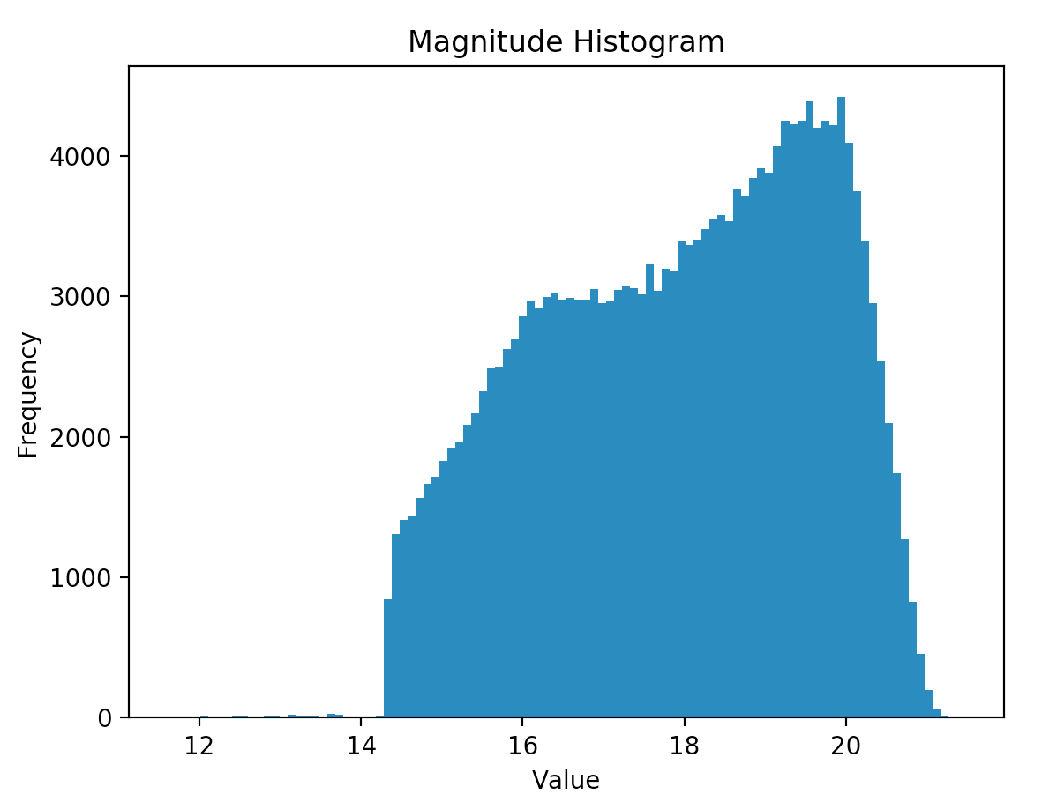
*Week 3 Update: Even more bins!

Slide 13
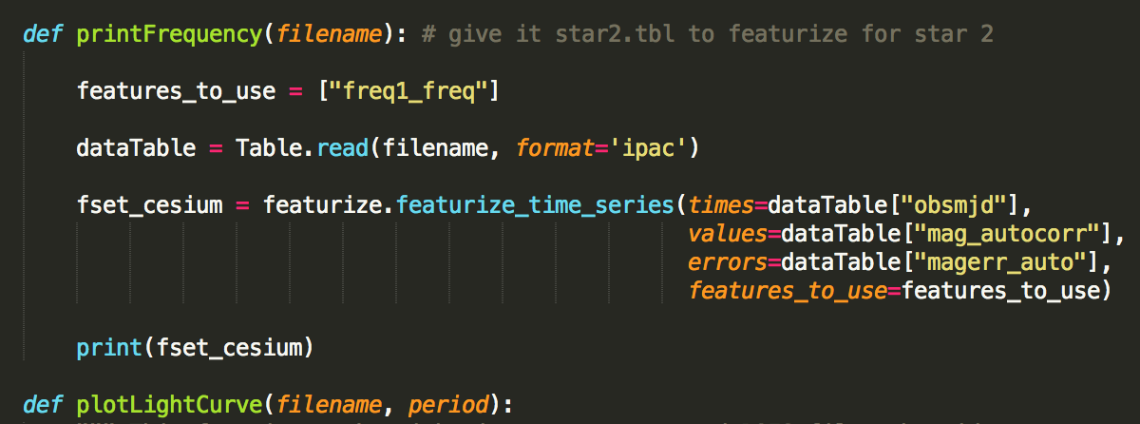
Used cesium-ml package to determine frequency -> period -> phase-folding!
Week 2:

Slide 14
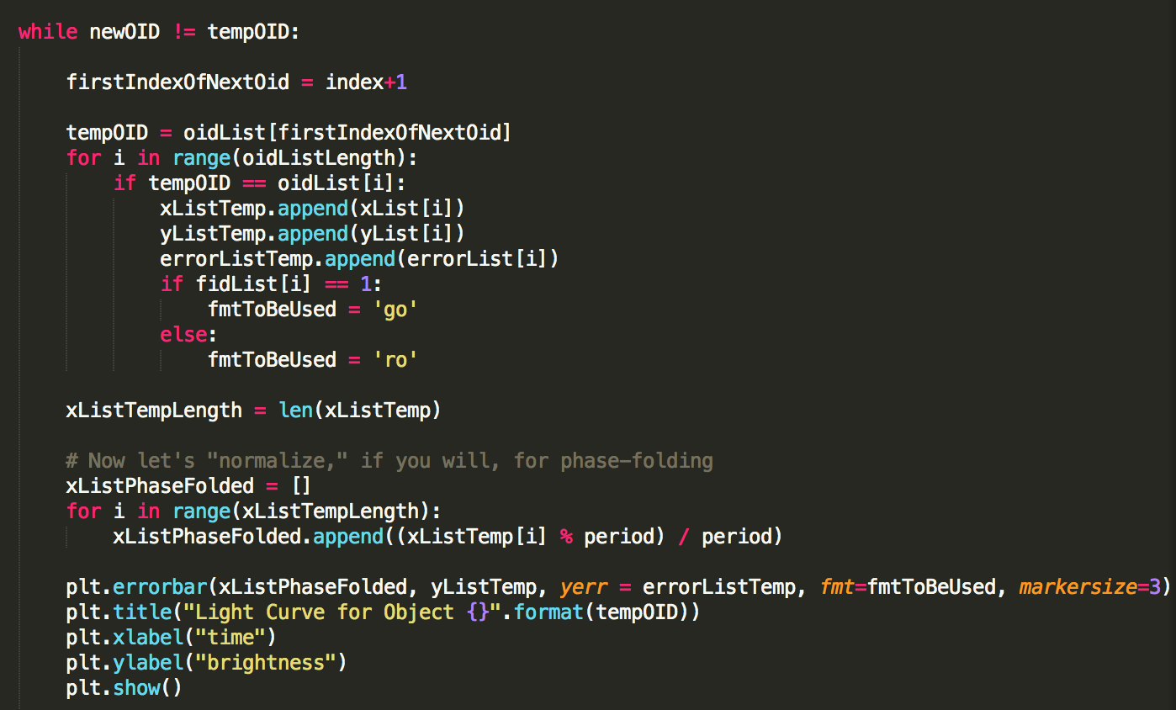
Phase folding software
Week 2:

Slide 15
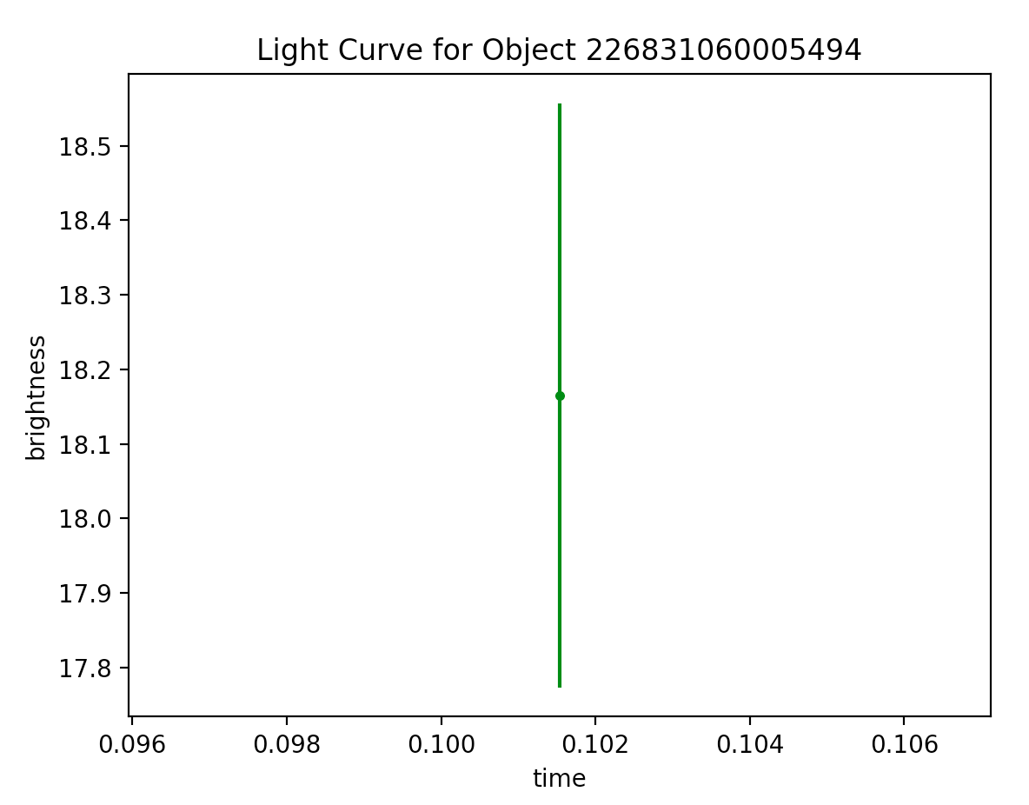
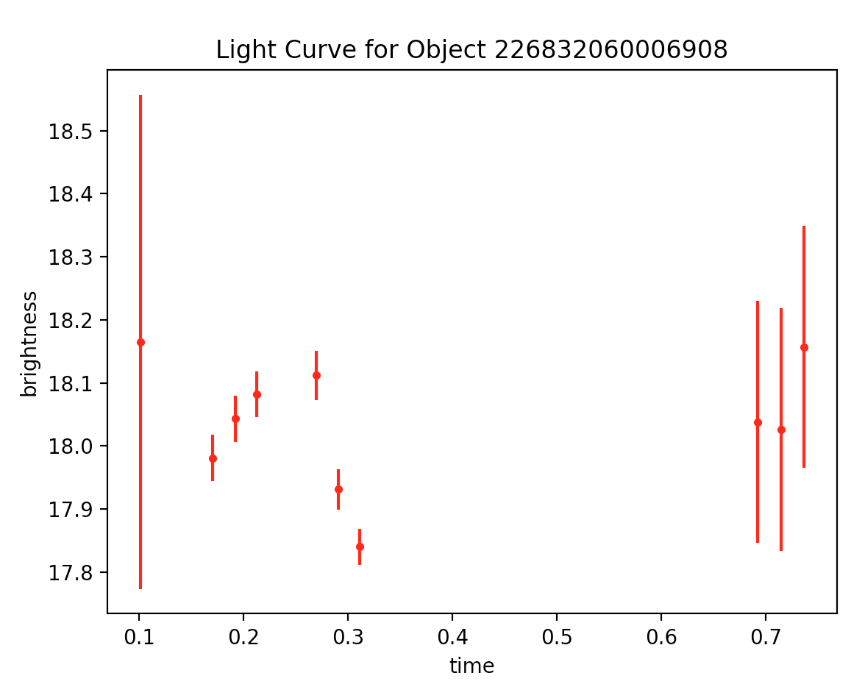
Star 2 Phase-folded Light Curves
Week 2:
Limited observations!

Slide 16
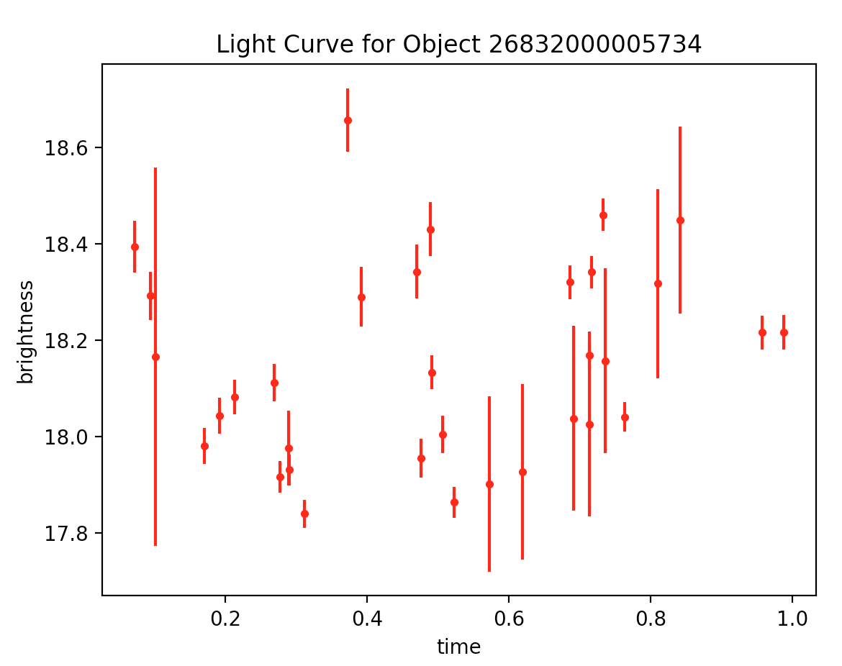
Star 2 Best Phase-folded Light Curve
Week 2:

Slide 17
Week 3:
Updated light curve software further…
Instead of loading the IRSA data in a dot .tbl file to use with cesium to obtain the period (for phase-folding) and also loading the IRSA data as a .txt file where I copy and pasted just the data, I updated the code so that it only loads the data once (just as a .tbl file)
Loaded the data using the cone feature search and did radius = 5 arcseconds (what I thought we had done before b/c -> 3 oid’s, whereas using the standard 10 arcsec -> 6 oid’s and light curves)
But the three light curves look different?
Will come back to this

Slide 18
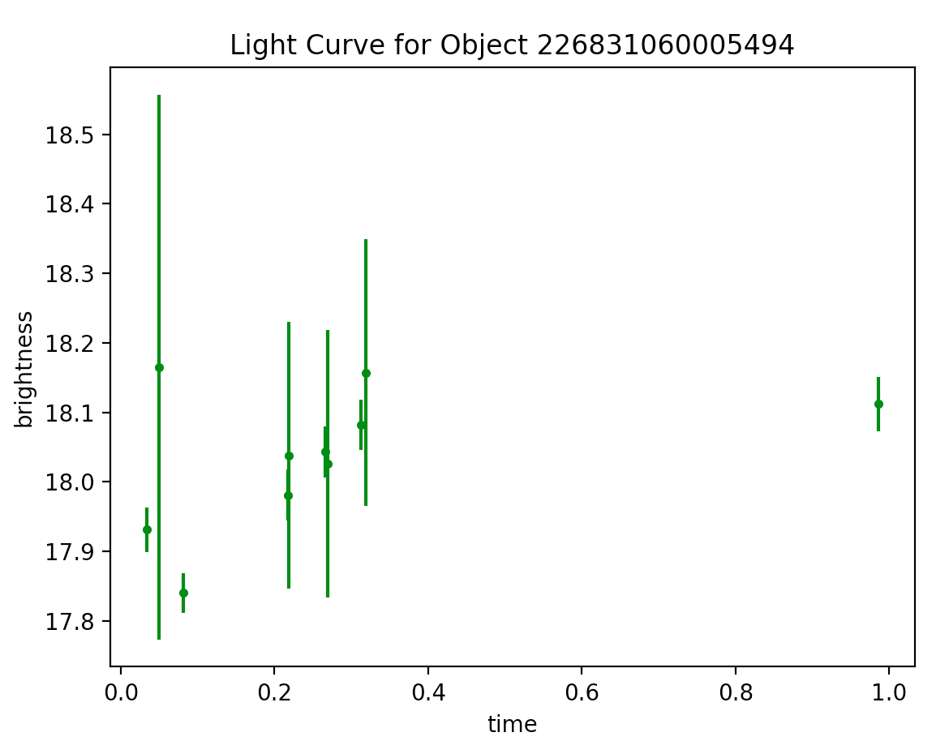
Week 3:
Star 2 Round 2
**There should not be more than one observation?**

Slide 19
→ Went back to editing the light curve software → reworked using strongest coding practices I know → one while loop that produces phase-folded light curves for any number of oid’s, i.e. however many there happen to be for the star we are working with (while loop instead of for loop precisely because number of oid’s is not fixed
Week 3:

Slide 20
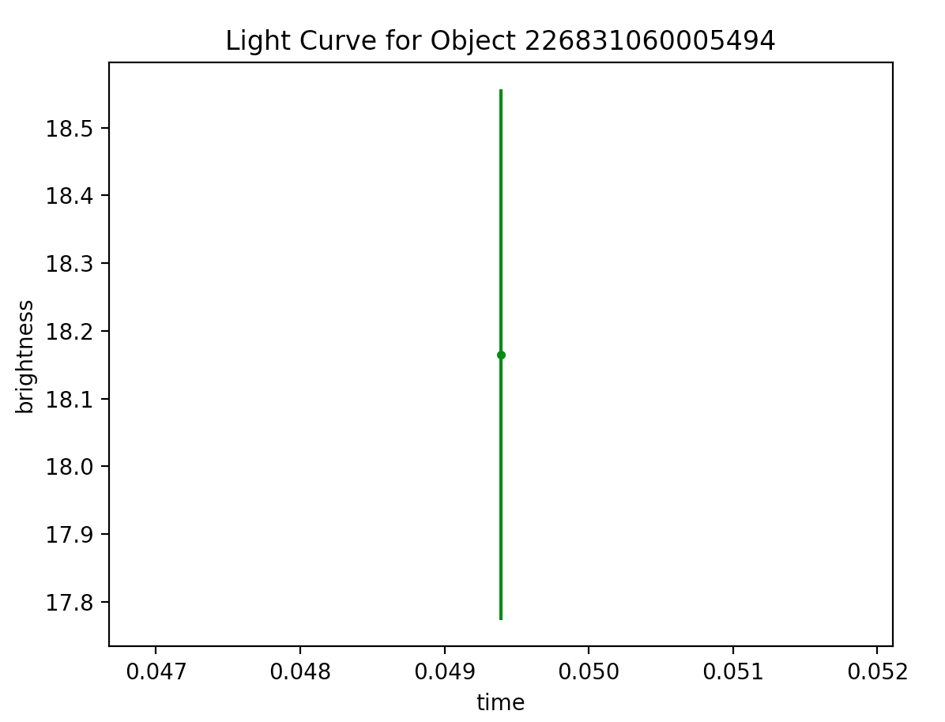
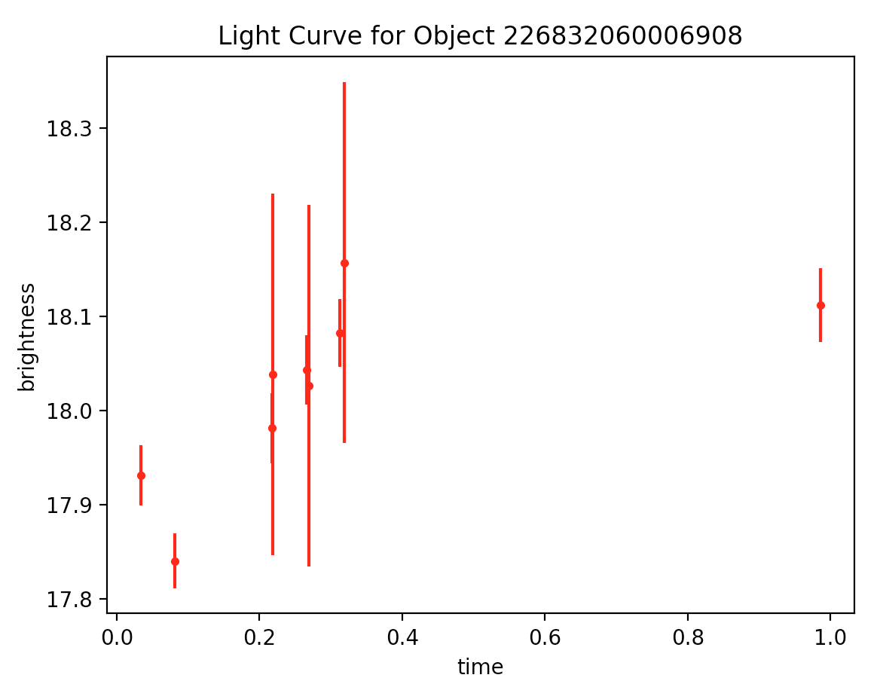
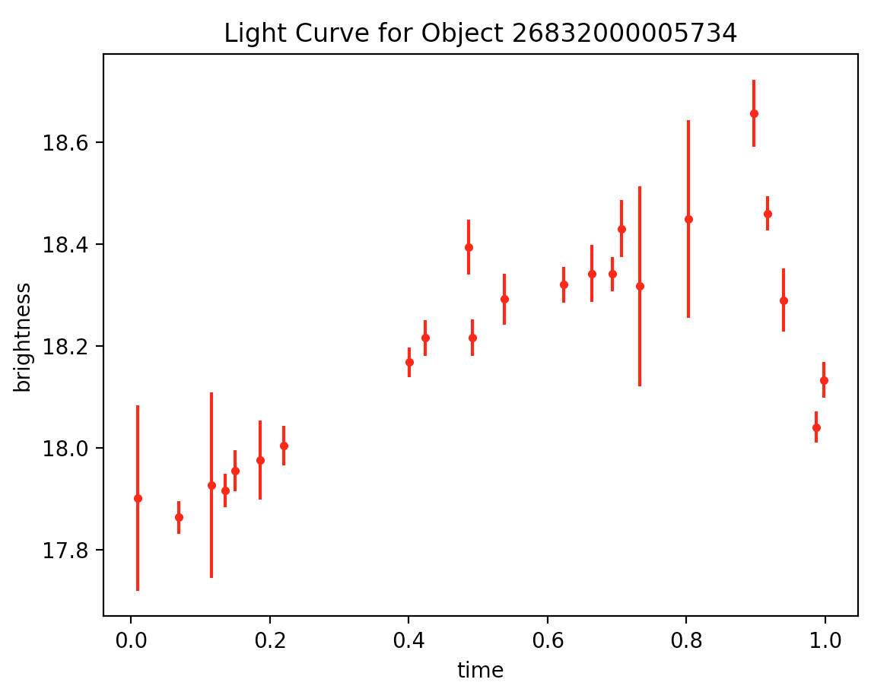
Week 3:
debugging → more debugging
Then one fine morning ---

Slide 21
Week 3:

Slide 22
Week 3:

Slide 23
Week 3:

Slide 24
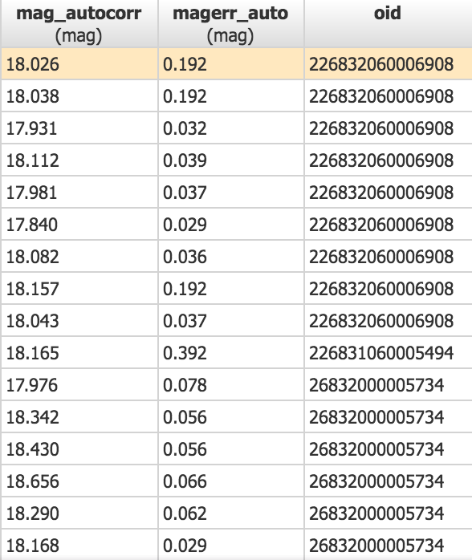
Verification of correctness (print statements are powerful!)
Week 3:
(NUREU17) Tanners-MBP:code tannerleighton$ python3 lightCurve.py
Enter .tbl filename: star2.tbl
feature freq1_freq
channel 0
0 1.594401
Enter the frequency: 1.594401
oid: 226832060006908
18.026
18.038
17.931
18.112
17.981
17.84
18.082
18.157
18.043
oid: 226831060005494
18.165
oid: 26832000005734
17.976
18.342
18.43
18.656
18.29
18.168
17.917
18.394
18.292
18.341
18.32
18.216
18.216
17.955
18.004
17.902
17.927
18.041
18.46
18.449
18.317
18.133
17.864
Screenshot of Caltech IRSA table reveals perfect match for star 2!

Slide 25
Week 3:
2nd star known RR Lyrae
Period is approximately 0.6 days (known)
Did I get this? Yes. Got 0.627 using cesium.

Slide 26
Recommendation for Next step
Week 3:
-> Matching light curves with types and understanding why various variable stars have the light curves that they do
Did research on pulsating variable stars (ch. 6 in Understanding Variable Stars and Google)
Can plot phased-folded light curves for others stars (plotting more stars -> training set)

Slide 27
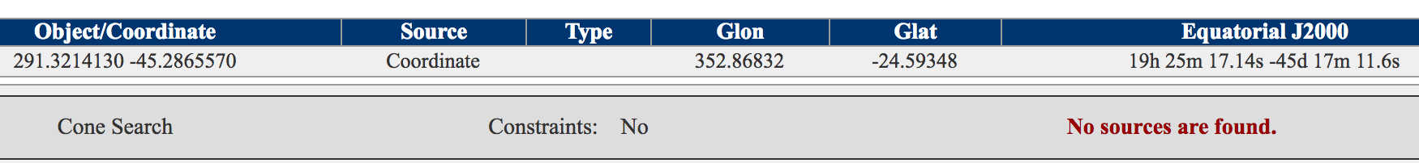
Week 3:
In approaching next step, decided to go ahead and produce more phase-folded light curves.
bestChiSQ > 100 and nbestobs > 100 results
But…
Was unable to generate PTF light curve data table. I tried increasing the radius from 10 to 20 arcseconds then to 30 arcseconds, but still -> “no sources found”
Also tried the box search….
Confused as I was able to get a table of data for this before...

Slide 28
Recommendation for (future) next steps
Week 3:
goal of this project: develop list of thousands of stars where we know their classifications (-> training set)
My initial idea: using a variable star’s position on H-R diagram along with its light curve -> more success in classifying
Although we do not at this time have sufficient information ot place on H-R diagram, we do have magnitude and color (though both are variable at some level). So we could make a color-magnitude diagram. The issue is that we don't have distance or redenning or metallicity information. So there's no easy way to precisely compare one star to another.
→GAIA: survey using parallax to measure distances will be done in the next year => something should keep in mind and may be able to incorporate down the road!

Slide 29
Monday, July 10, 2017

Slide 30
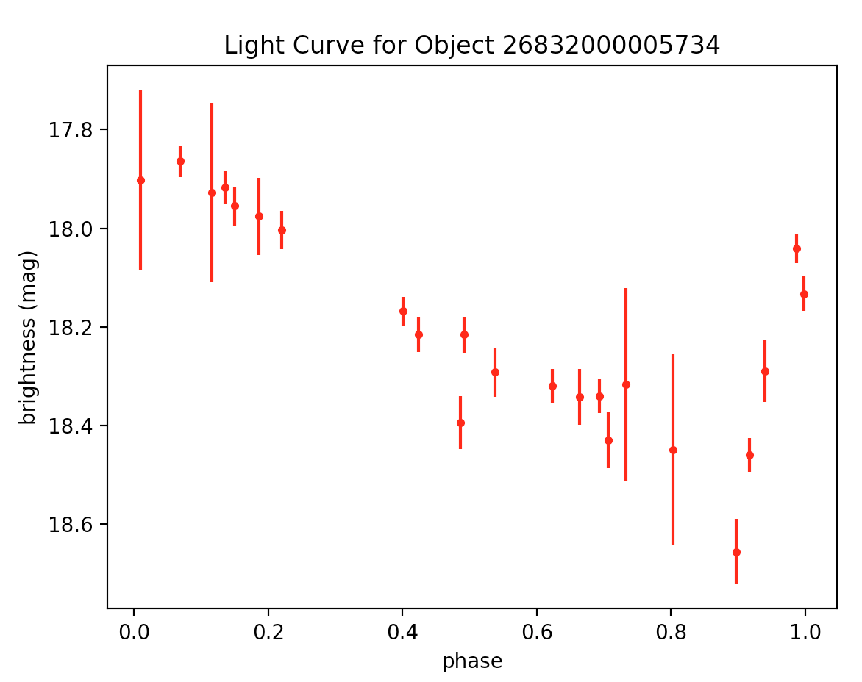
Week 3:
Re-plotting star 2 (RR Lyrae) with proper axes

Slide 31
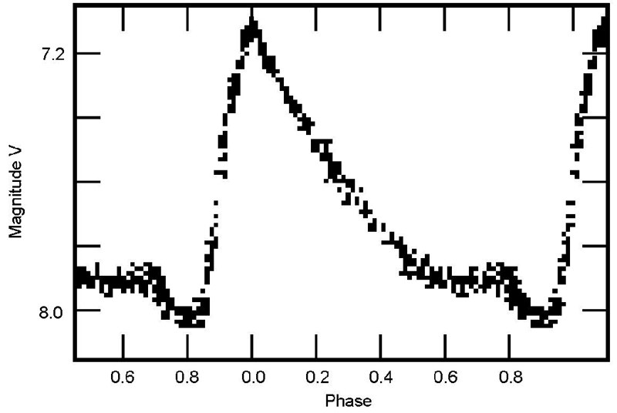
Week 3:
RR Lyrae
Comparing ‘experimental’ to ‘theoretical’

Slide 32
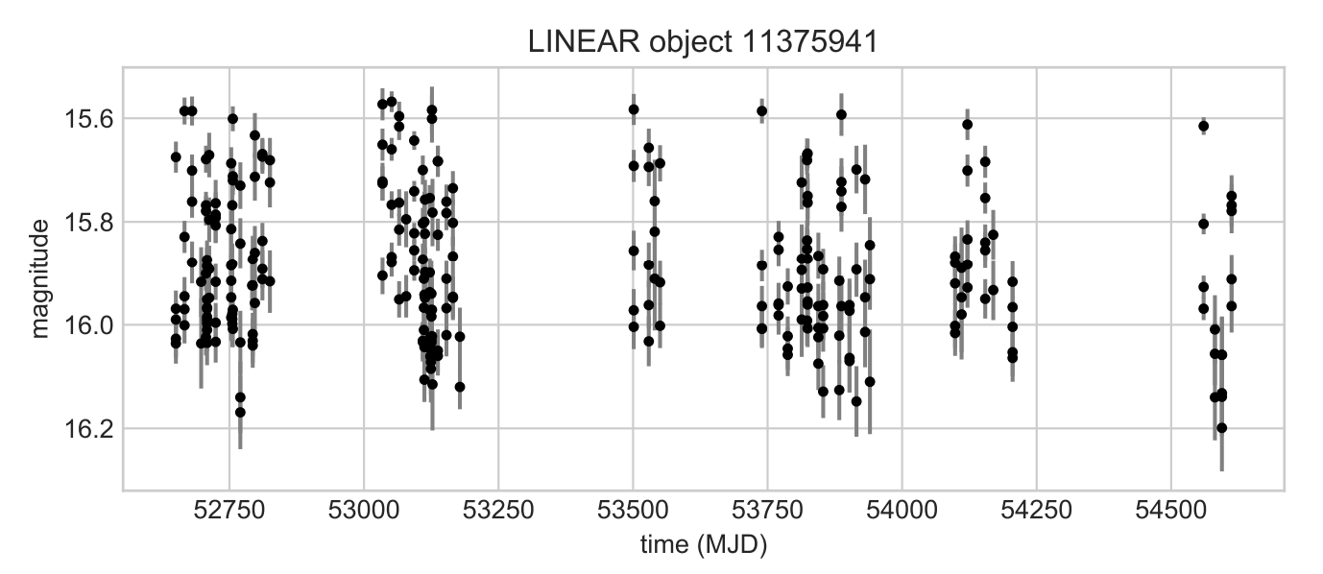
Lomb-Scargle Paper (VanderPlas)
Week 3:
The Lomb-Scargle periodogram is a well-known algorithm for detecting and characterizing periodic signals in unevenly-sampled data.
------------------------> (see next slide)

Slide 33
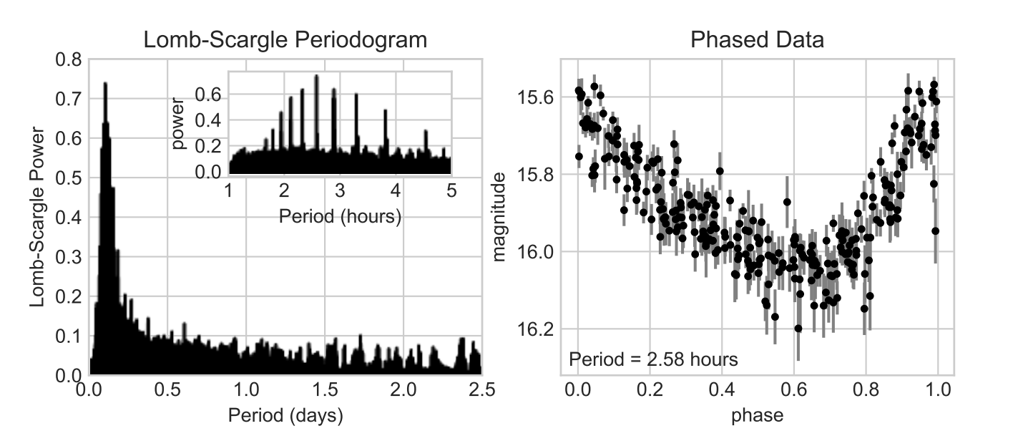
Week 3:

Slide 34
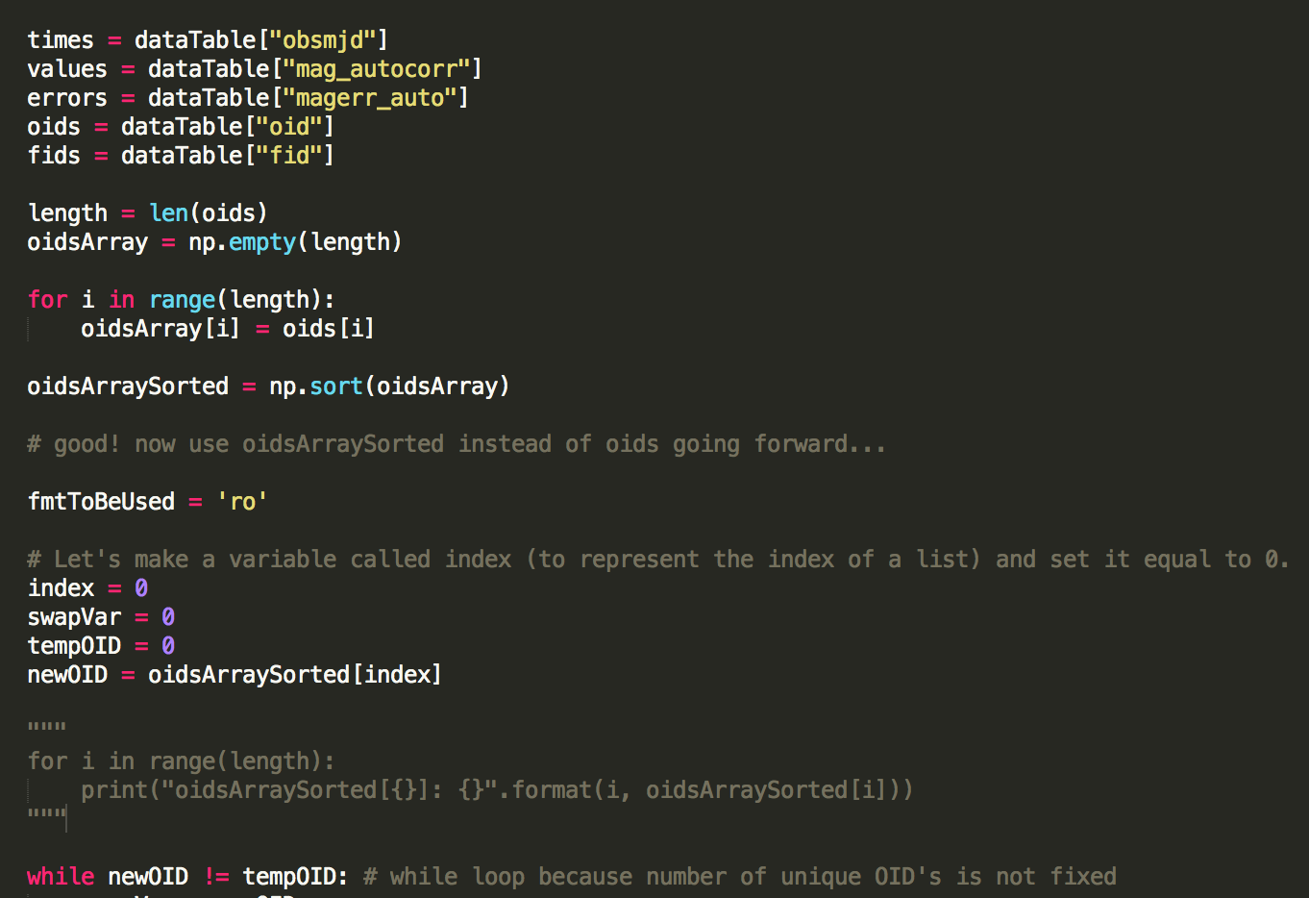
Back to the software…
Week 3:

Slide 35
Updates to software
Week 3:
Improved further
Not plotting for all oids (went back and got ride of lists)
Not plotting for all of them and no errors (and code is robust :)
What if the oids are not grouped? -> np.where
Put the object id’s in order so doesn’t make same light curve mulitple times
Future improvements
improve light curve for object 1232.0 (get rid of .0)
for lyrae9.tbl plotting two extra plots that I don't see in the table on IRSA?
downloaded it again with 1 arc sec and did not get desired result

Slide 36
RRL ab, c, d
Week 3:
Cepheid stars and RR Lyrae stars are variable because they pulsate in and out
Variable stars of RR Lyrae type are a prime tool to obtain distances to old stellar populations in the Milky Way, and one of the main aims of the Vista Variables in the Via Lactea (VVV) near-infrared survey is to use them to map the structure of the Galactic Bulge. Due to the large number of expected sources, this requires an automated mechanism for selecting RR Lyrae, and particularly those of the more easily recognized type ab (i.e., fundamental-mode pulsators), from the 10^6-10^7 variables expected in the VVV survey area. In this work we describe a supervised machine-learned classifier constructed for assigning a score to a K_s-band VVV light curve that indicates its likelihood of being ab-type RR Lyrae.
=> RRL ab (fundamental-mode pulsators) -> c, and d pulsating in non-fundamental modes (and different modes from each other <=> otherwise they wouldn't be different categories of c and d)
RR Lyrae stars pulsating in the fundamental mode have long been used to measure interstellar reddening (what is that?), based on their observed uniformity of B−V color at minimum light after small corrections for metallicity and period are applied. However, little attention has been paid to the first overtone pulsators (RRc or RR1). We present new V−I observations of field RRc stars, supplemented with published data from uncrowded RRc in globular clusters. Preliminary results indicate the RRc colors are correlated with period, but appear to be independent of the stars' metallicity. The scatter around the period-color relation is slightly larger than a comparable relation for RRab. Thus, RRc can be useful indicators of line of sight reddening toward old stellar systems, particularly when multiple stars are available as in Oosterhoff II globular clusters and metal-poor galaxies.
=> RRL type c (first overtone pulsators) => RRL d (second overtone?)
so we need to decide if we want to differentiate between the various RR Lyrae types on zooniverse or if we want to just group them as one
does being different mode of pulsating -> different period and light curve? (It has to if we do want to differentiate them)

Slide 37
RR Lyrae
Week 3:
Period: 0.1 – 1 day
Going after 3 golden examples and 3 average examples for zooniverse project
Will find the following at: http://vizier.cfa.harvard.edu/viz-bin/VizieR-3?-source=J/MNRAS/398/1757/lyraes
Then change preference to ascii text/plain and hit submit
Came from here:
http://adsabs.harvard.edu/abs/ 2009MNRAS.398.1757W

Slide 38
Week 4

Slide 39
Task: Find 3 ‘golden’ and 3 ‘average’ examples for RRab and RRc
Week 4:

Slide 40
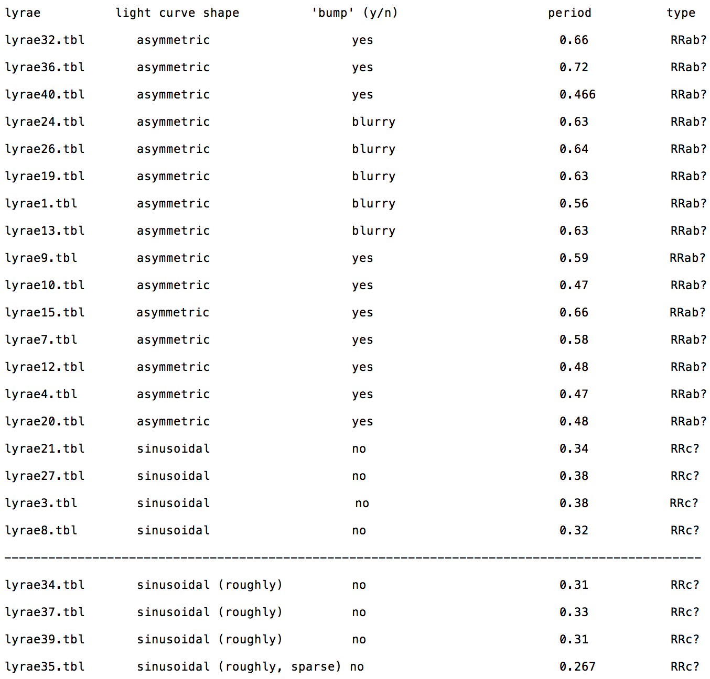

Slide 41
Week 4
General Findings / Take-aways / What is physically different?:
RR Lyrae periods 0.1 - 1 day (Understanding Variable Stars textbook)
asymmetric => steep up then gradual decline <==> ‘bump’ (or blurry)
sinusoidal <==> no 'bump’
sinusoidal: period between 0.32 - 0.38 days for best (i.e. most clear) plots sampled and
0.31 - 0.38 days including ‘roughly’ sinusoidal plots and 0.267 - 0.38 days including a plot that is roughly sinusoidal and whose data points are sparse.
asymmetric: period between 0.466 - 0.72 days (didn't have the same tiers of data)
extrapolating -> something like 0.30 - 0.435 days for sinusoidal & no 'bump' (i.e. RRc) whereas approximately 0.44 - 0.75 days for asymmetric & 'bump’ (i.e. RRab)
=>? RRd could have period like 0.1 - 0.25 days and/or 0.75 - 1 day (how do frequencies add like f = f1 + f2 or reciprocals?)
Another possibility is that RRd is distinguished by light curve character
Consistent with: http://iopscience.iop.org/article/10.1086/300883/fulltext/ => “With the discovery of new RR Lyrae variables, the mean periods of the RRab and RRc variables are ⟨Pab⟩ = 0.685 ± 0.022 days and ⟨Pc⟩ =0.333 ± 0.013 days, respectively.”

Slide 42
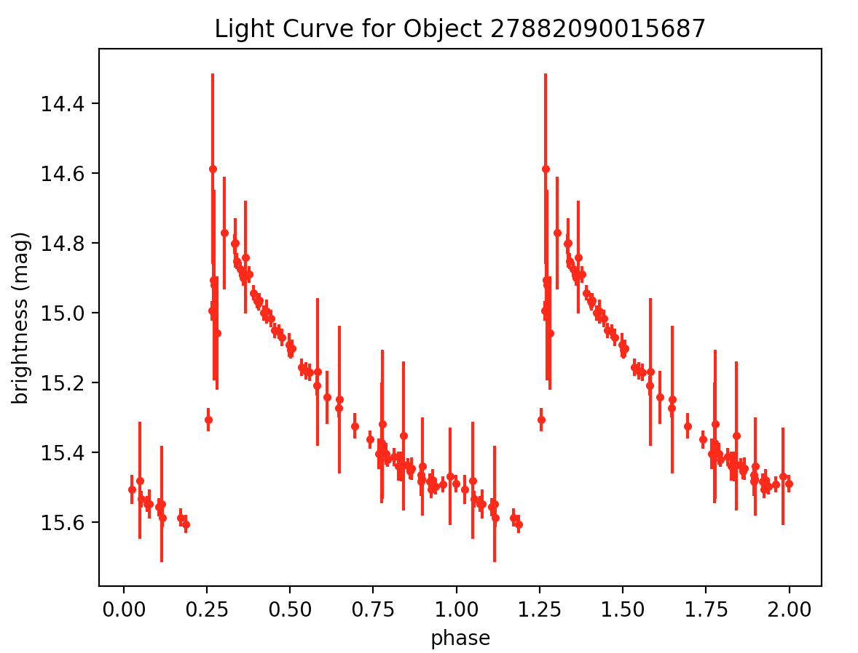
Week 4:
lyrae32.tbl – 20 56 40.2 +01 02 44 – period: 0.6633169162396564 – RRab Golden 1 – http://vizier.cfa.harvard.edu/viz-bin/VizieR-3?-source=J/MNRAS/398/1757/lyraes

Slide 43
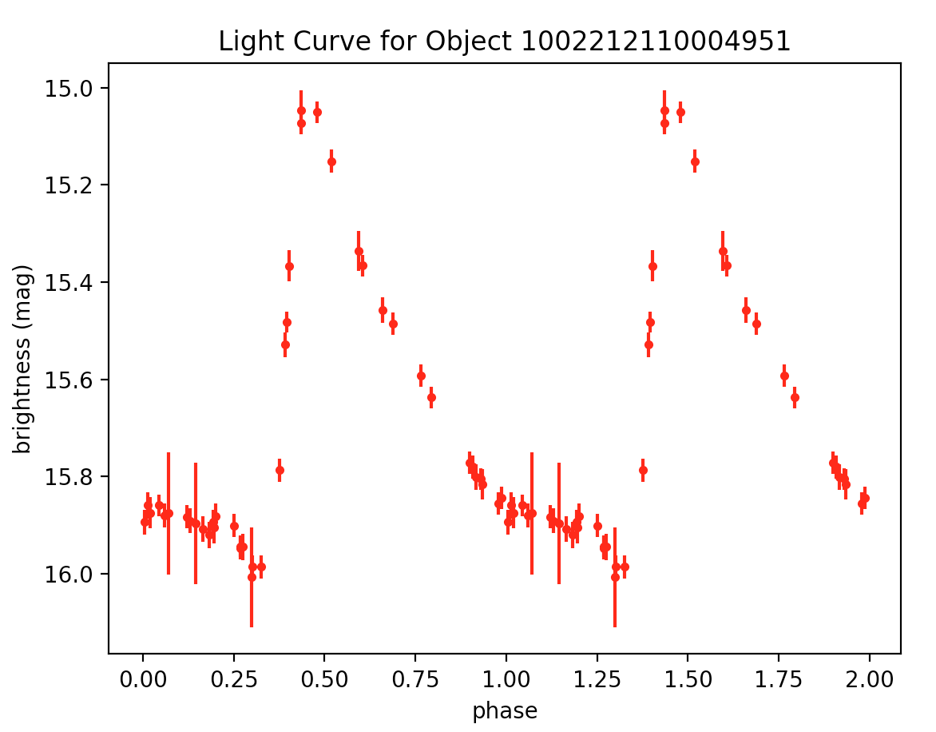
Week 4:
lyrae9.tbl – 20 48 14.9 +00 07 05 – period: 0.5851614753091116 – RRab Golden 2 – http://vizier.cfa.harvard.edu/viz-bin/VizieR-3?-source=J/MNRAS/398/1757/lyraes

Slide 44
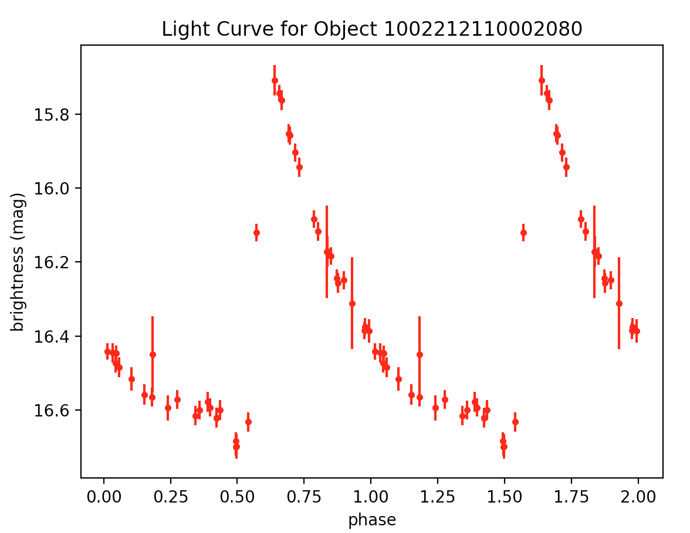
Week 4:
lyrae10.tbl – 20 48 30.5 -00 04 26 – period: 0.4700500556304241 – RRab Golden 3 – http://vizier.cfa.harvard.edu/viz-bin/VizieR-3?-source=J/MNRAS/398/1757/lyraes

Slide 45
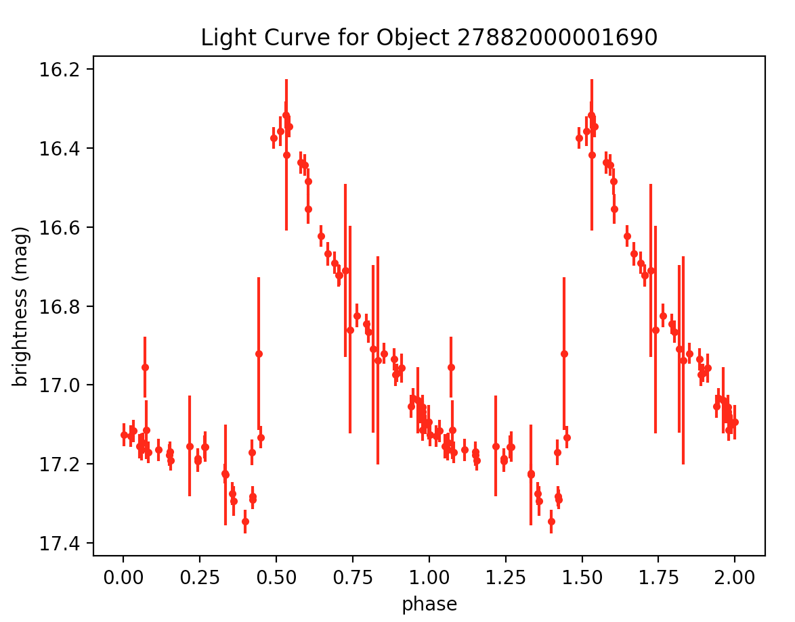
Week 4:
lyrae20.tbl – 20 50 01.9 +01 12 50 – period: 0.47739464735573495 – RRab Average 1
– http://vizier.cfa.harvard.edu/viz-bin/VizieR-3?-source=J/MNRAS/398/1757/lyraes

Slide 46
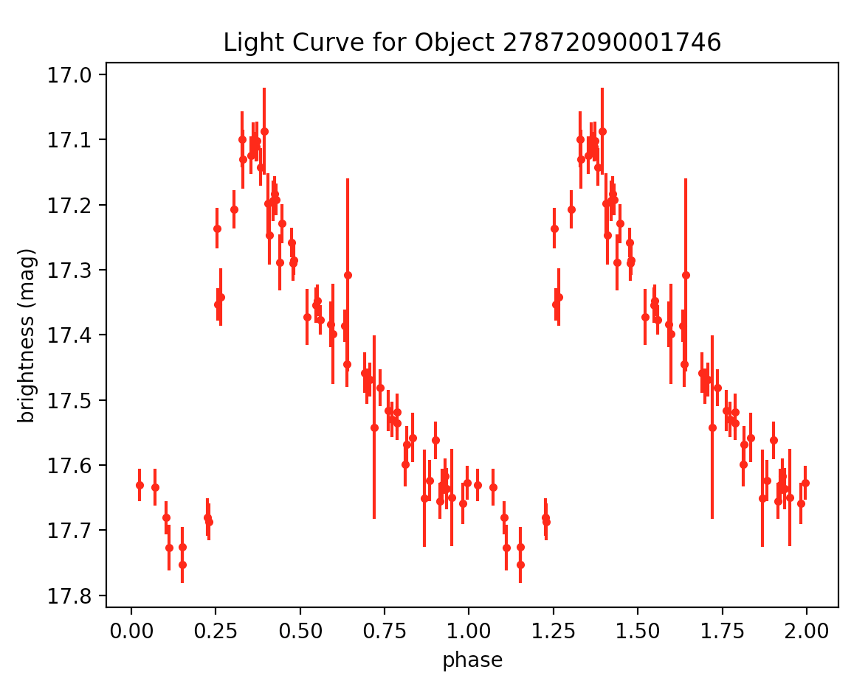
Week 4:
lyrae1.tbl - 20:42:47.8 00:03:52 – period: 0.561844783636383 – RRab Average 2
– http://vizier.cfa.harvard.edu/viz-bin/VizieR-3?-source=J/MNRAS/398/1757/lyraes

Slide 47
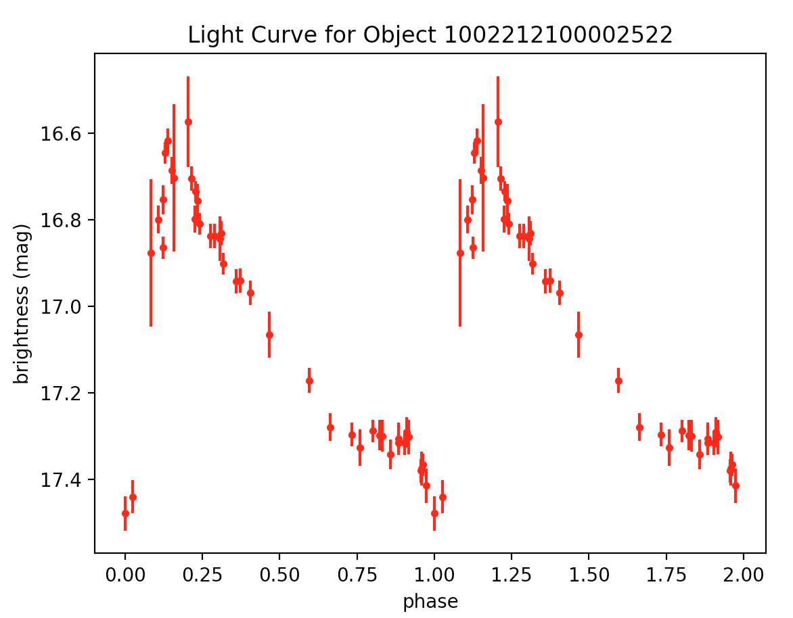
Week 4:
lyrae7.tbl – 20 46 11.2 -00 02 33 – period: 0.5821477409465838 – RRab Average 3 – http://vizier.cfa.harvard.edu/viz-bin/VizieR-3?-source=J/MNRAS/398/1757/lyraes

Slide 48
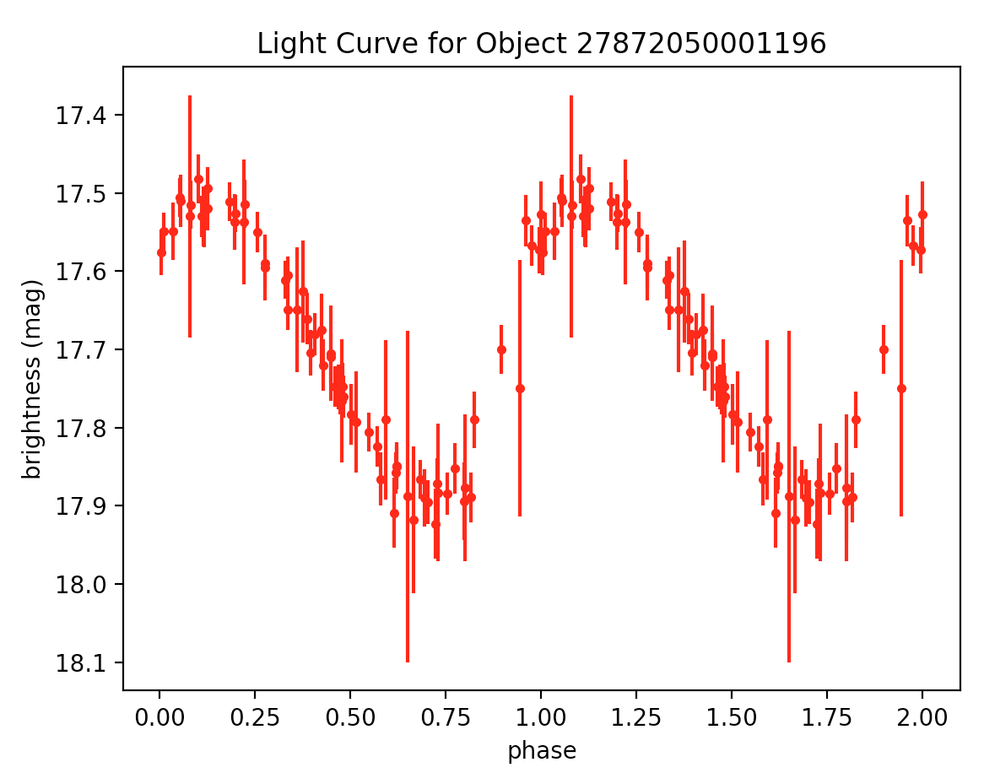
Week 4:
lyrae8.tbl – 20 46 24.8 +01 11 55 – period: 0.32499810688602737 – RRc Golden 1 – http://vizier.cfa.harvard.edu/viz-bin/VizieR-3?-source=J/MNRAS/398/1757/lyraes

Slide 49
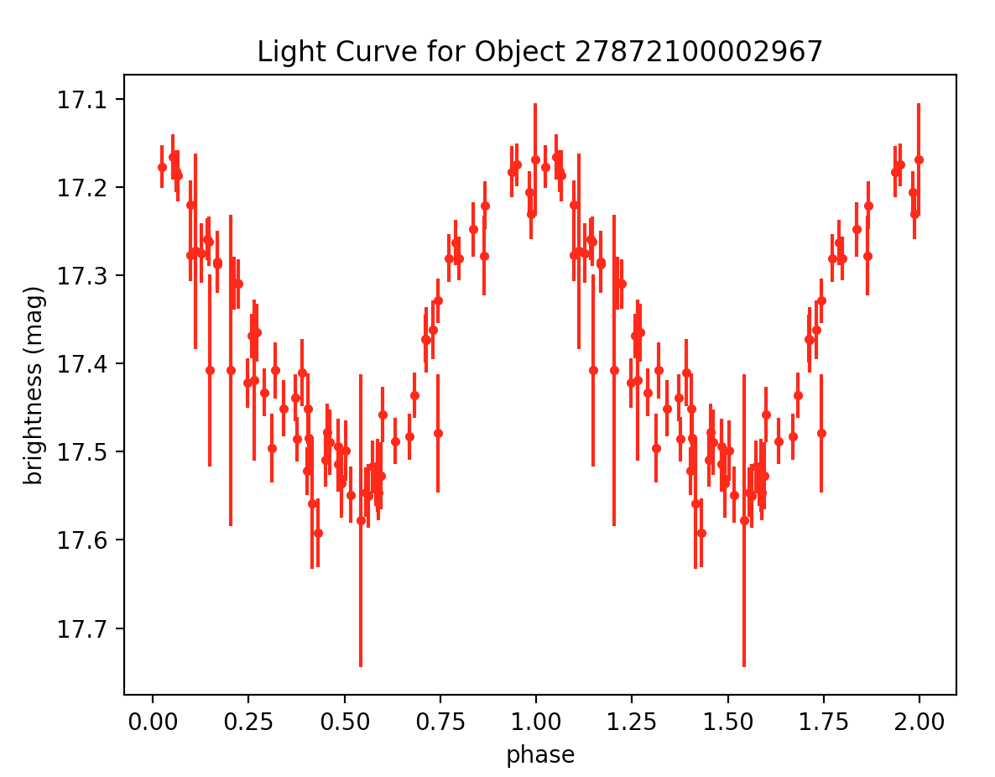
Week 4:
lyrae3.tbl – 20 44 50.9 +00 11 20 – period: 0.37561549293711405 – RRc Golden 2 – http://vizier.cfa.harvard.edu/viz-bin/VizieR-3?-source=J/MNRAS/398/1757/lyraes

Slide 50
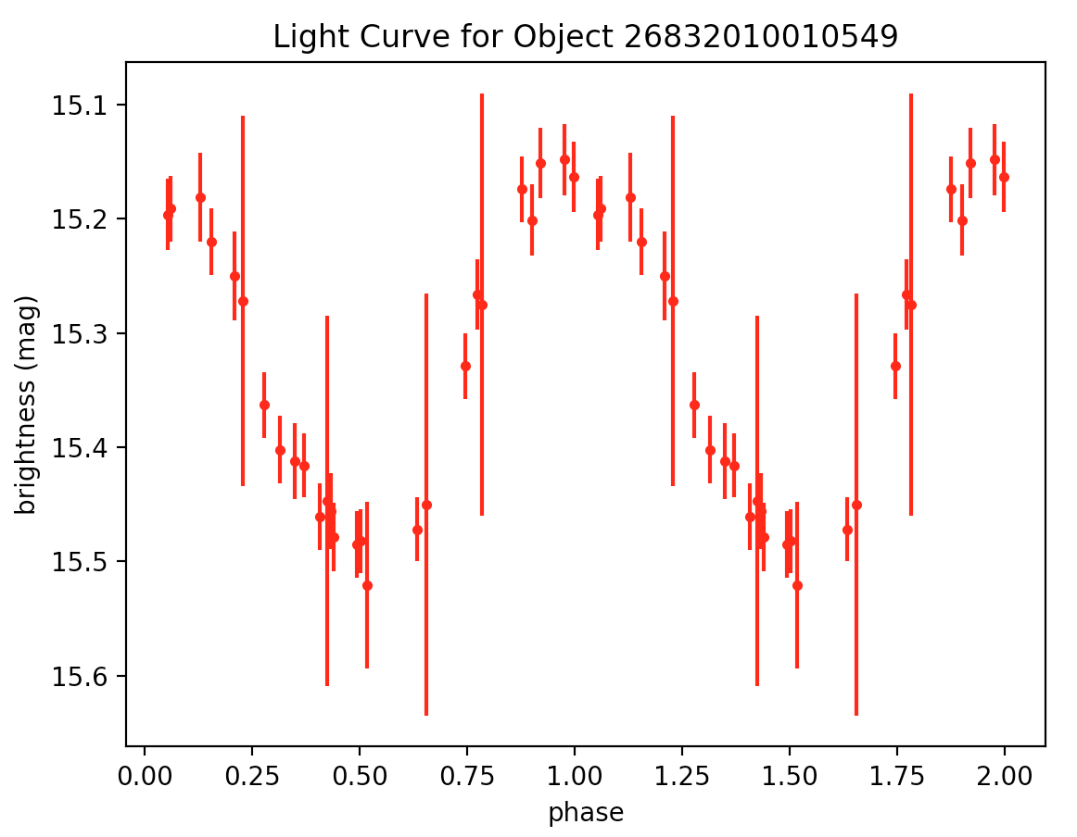
Week 4:
lyrae21.tbl – 20 50 15.7 -00 08 52 – period: 0.3401154623971746 – RRc Golden 3 – http://vizier.cfa.harvard.edu/viz-bin/VizieR-3?-source=J/MNRAS/398/1757/lyraes

Slide 51
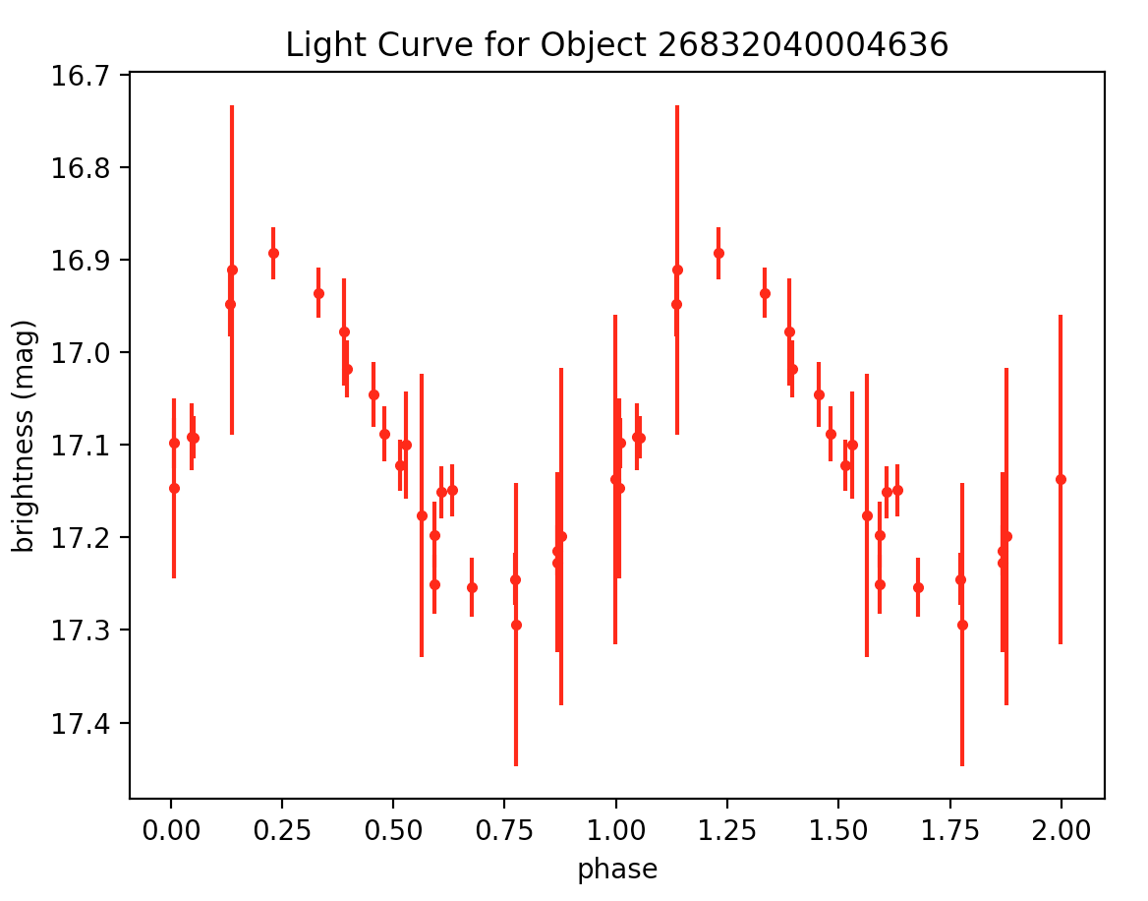
Week 4:
lyrae34.tbl – 20 57 43.8 -00 44 50 – period: 0.3132667202979292 – RRc Average 1
– http://vizier.cfa.harvard.edu/viz-bin/VizieR-3?-source=J/MNRAS/398/1757/lyraes

Slide 52
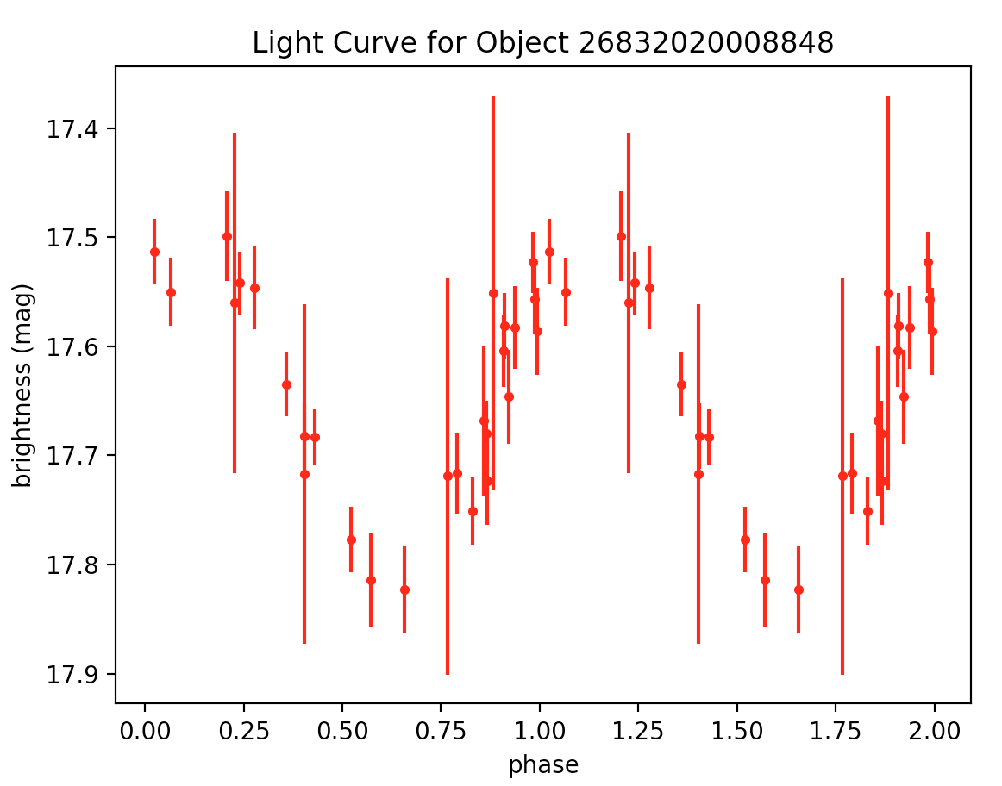
Week 4:
lyrae27.tbl – 20 53 21.3 -00 20 50 – period: 0.3763623375714241 – RRc Average 2 – http://vizier.cfa.harvard.edu/viz-bin/VizieR-3?-source=J/MNRAS/398/1757/lyraes

Slide 53
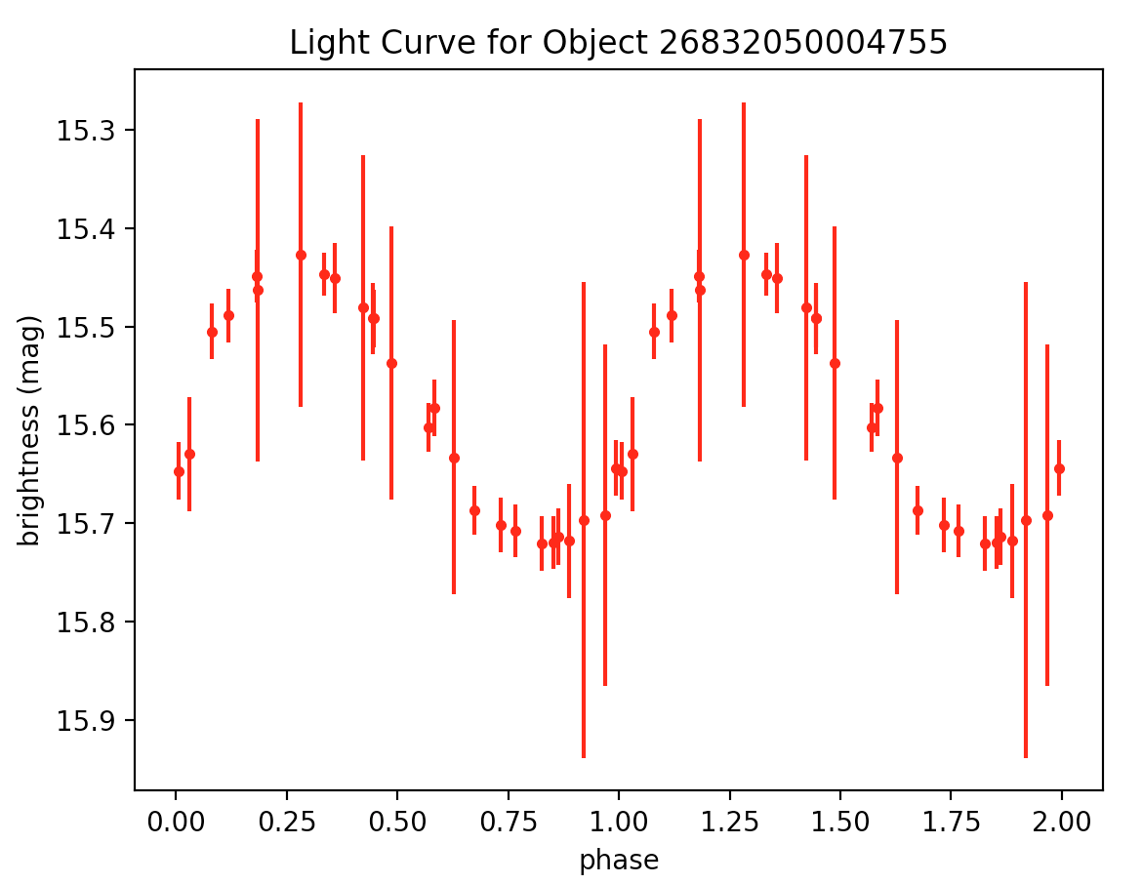
Week 4:
lyrae39.tbl – 20 59 55.2 -00 42 44 – period: 0.31028610861503175 – RRc Average 3 – http://vizier.cfa.harvard.edu/viz-bin/VizieR-3?-source=J/MNRAS/398/1757/lyraes

Slide 54
EXTRA (RR Lyrae)

Slide 55
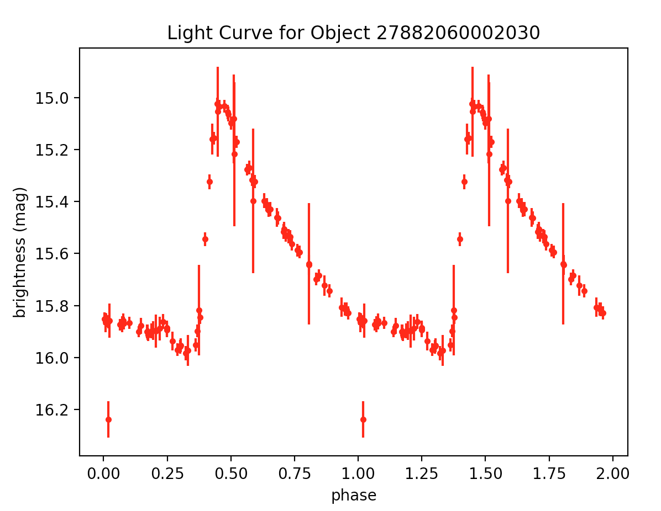
lyrae9.tbl – 20 48 14.9 +00 07 05 – period: 0.5851614753091116 – http://vizier.cfa.harvard.edu/viz-bin/VizieR-3?-source=J/MNRAS/398/1757/lyraes

Slide 56
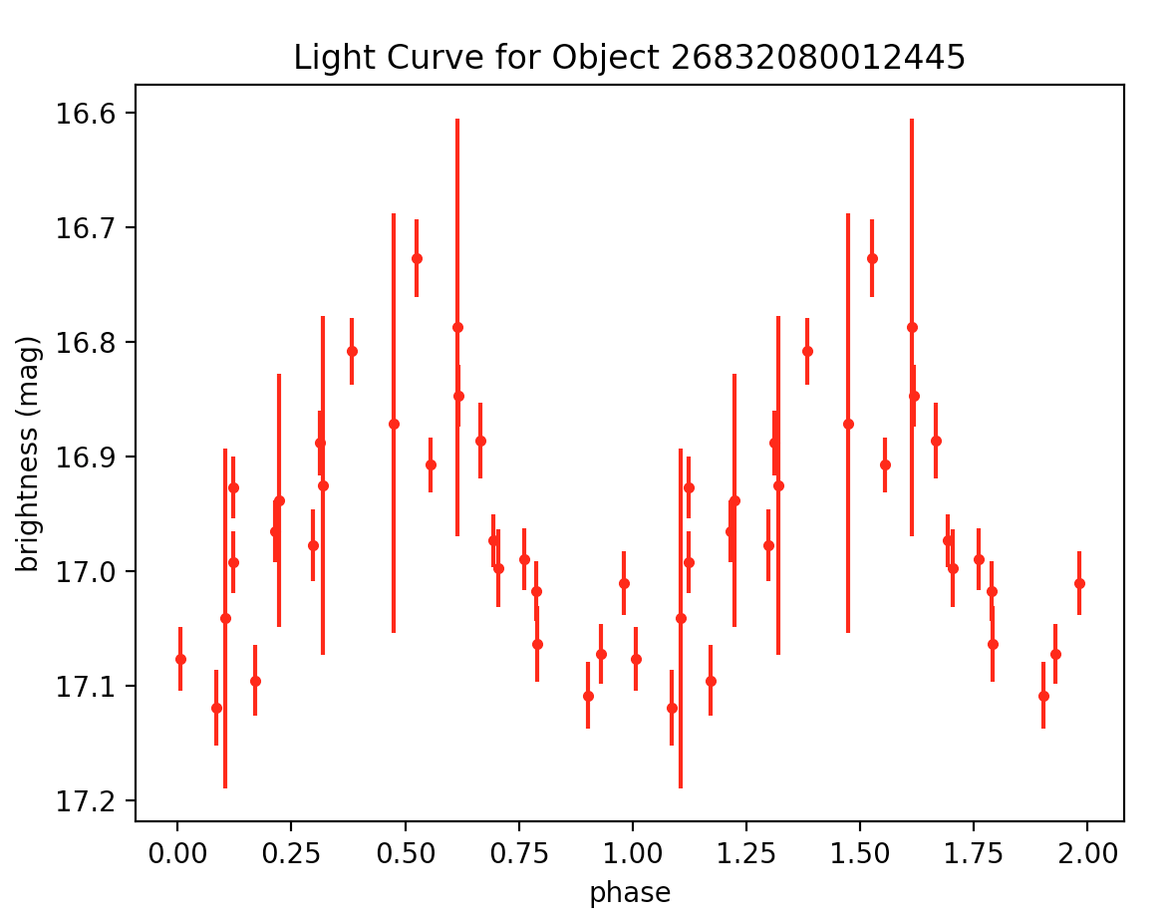
lyrae25.tbl – 20 52 42.7 -01 11 25 – period: 0.31165385977072246 – http://vizier.cfa.harvard.edu/viz-bin/VizieR-3?-source=J/MNRAS/398/1757/lyraes

Slide 57
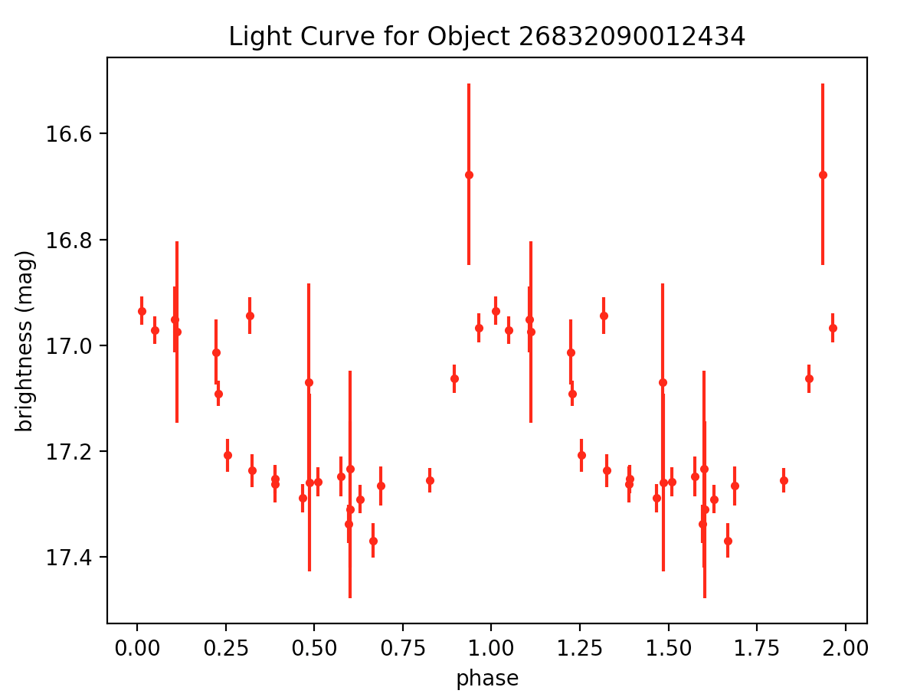
lyrae31.tbl – 20 55 21.3 -01 10 47 – period: 0.37669820258452635 – http://vizier.cfa.harvard.edu/viz-bin/VizieR-3?-source=J/MNRAS/398/1757/lyraes

Slide 58
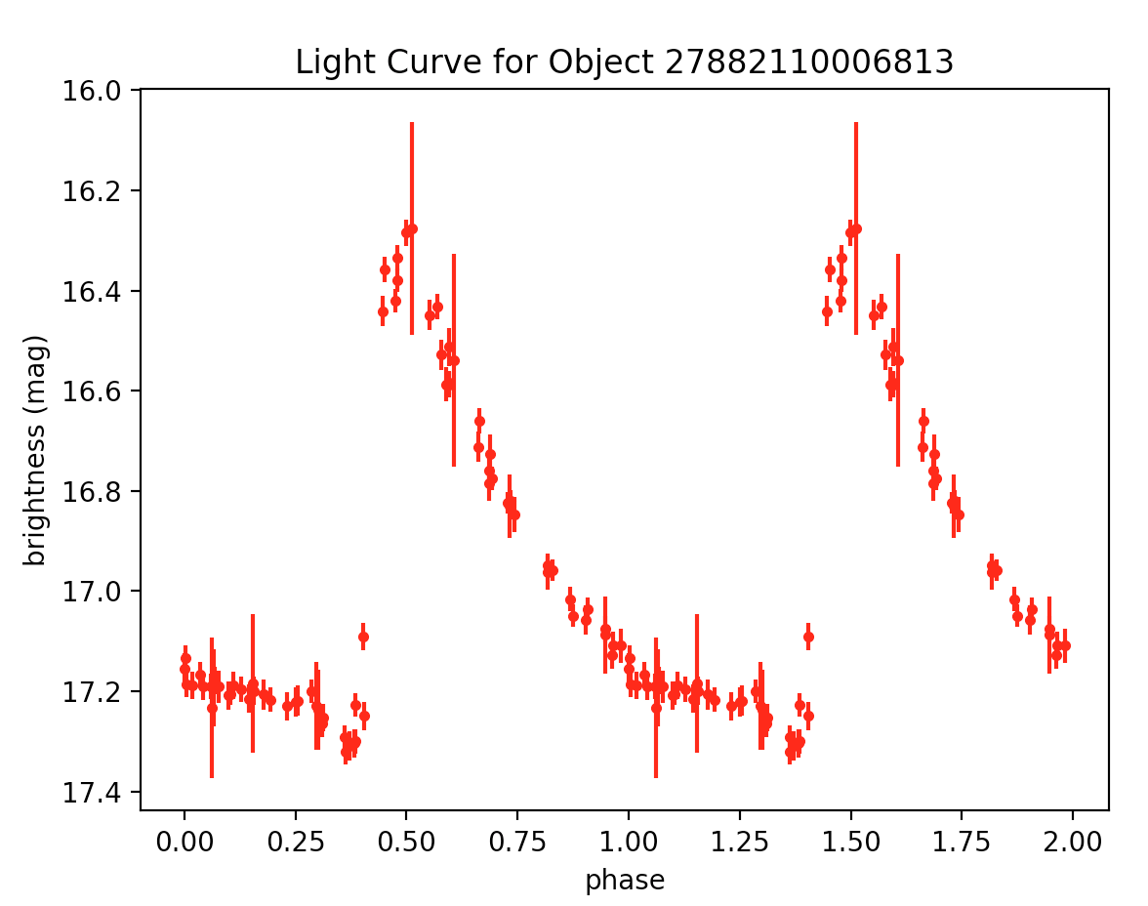
lyrae4.tbl – 21 00 08.7 +00 27 02 – period: 0.4661441811921079 – http://vizier.cfa.harvard.edu/viz-bin/VizieR-3?-source=J/MNRAS/398/1757/lyraes

Slide 59
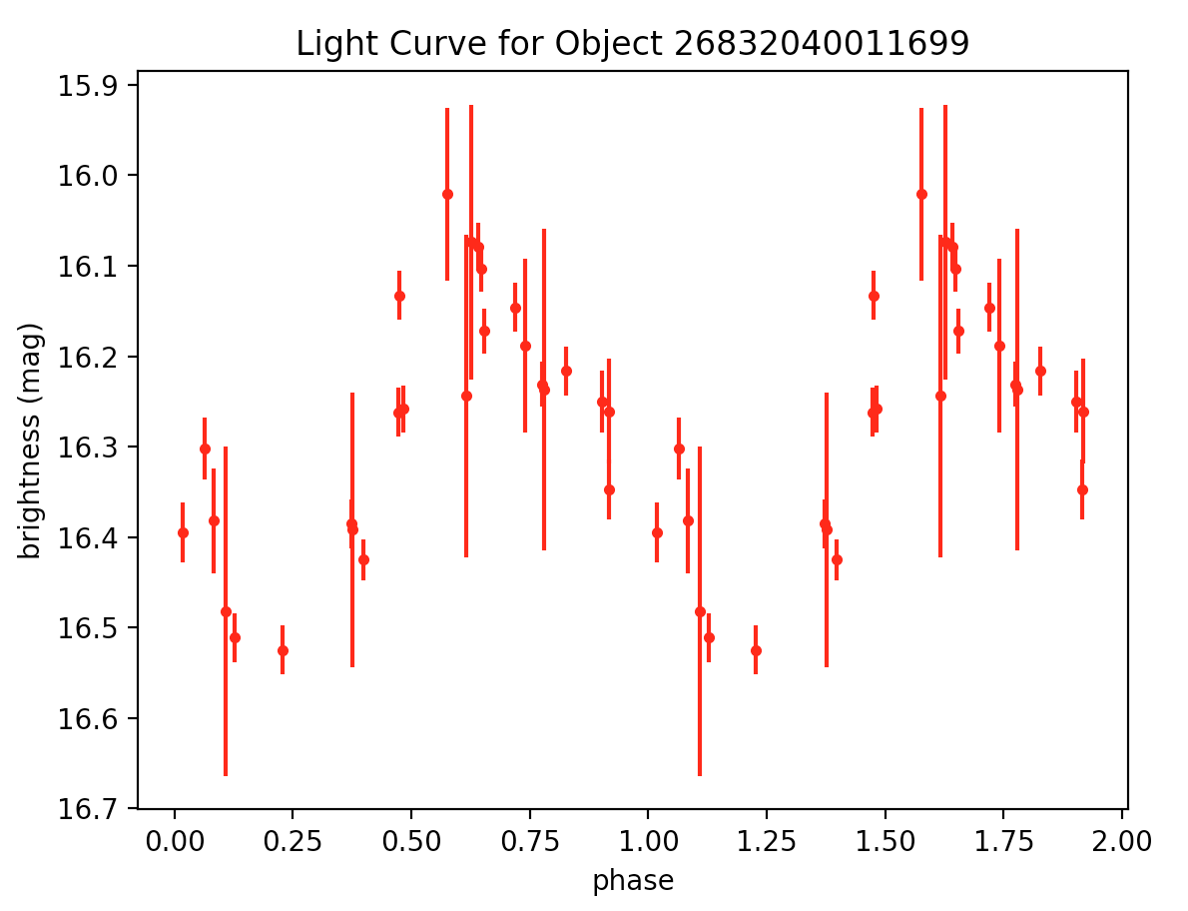
lyrae35.tbl – 20 57 59.1 -00 12 33 – period: 0.266690206522229 – http://vizier.cfa.harvard.edu/viz-bin/VizieR-3?-source=J/MNRAS/398/1757/lyraes

Slide 60
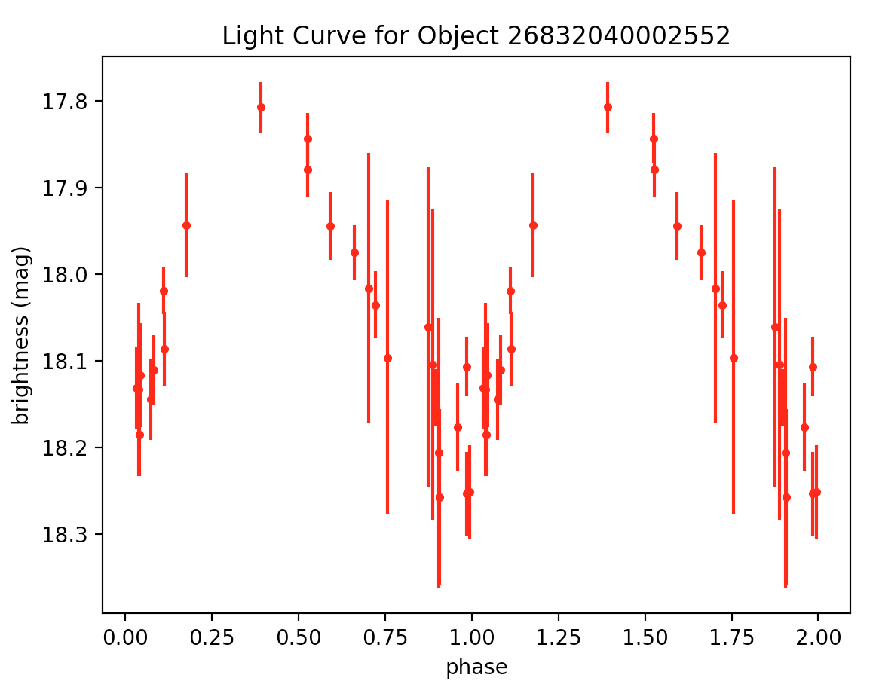
lyrae37.tbl – 20 58 52.3 -00 55 36 – period: 0.32951393728624845 – http://vizier.cfa.harvard.edu/viz-bin/VizieR-3?-source=J/MNRAS/398/1757/lyraes

Slide 61
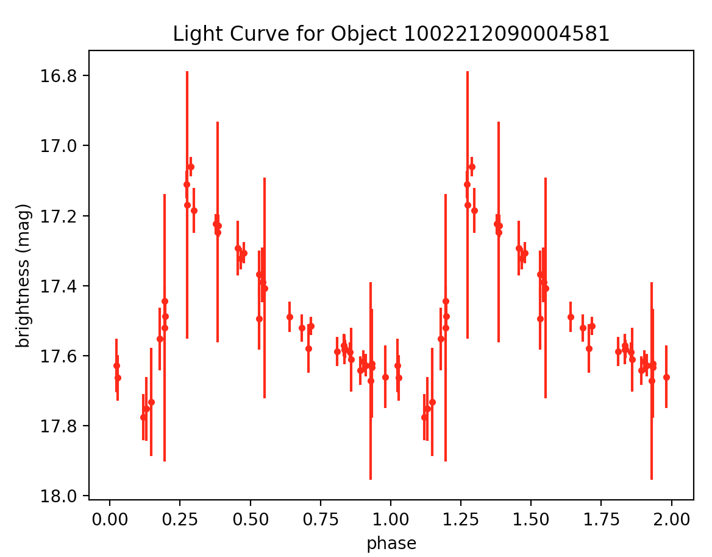
lyrae1.tbl - 20:42:47.8 00:03:52 - period: 0.561844783636383 – http://vizier.cfa.harvard.edu/viz-bin/VizieR-3?-source=J/MNRAS/398/1757/lyraes

Slide 62
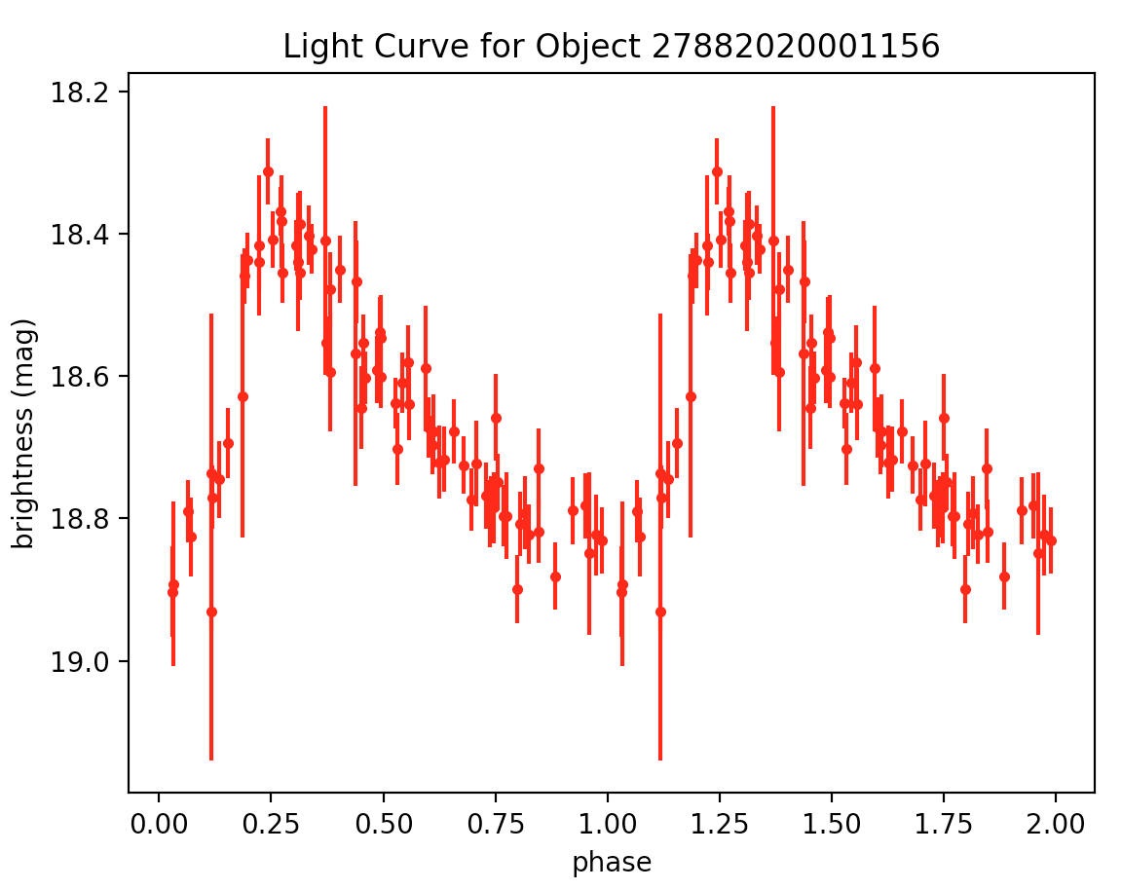
lyrae13.tbl – 20 52 41.8 +01 10 33 – period: 0.6333033991926649 – http://vizier.cfa.harvard.edu/viz-bin/VizieR-3?-source=J/MNRAS/398/1757/lyraes

Slide 63
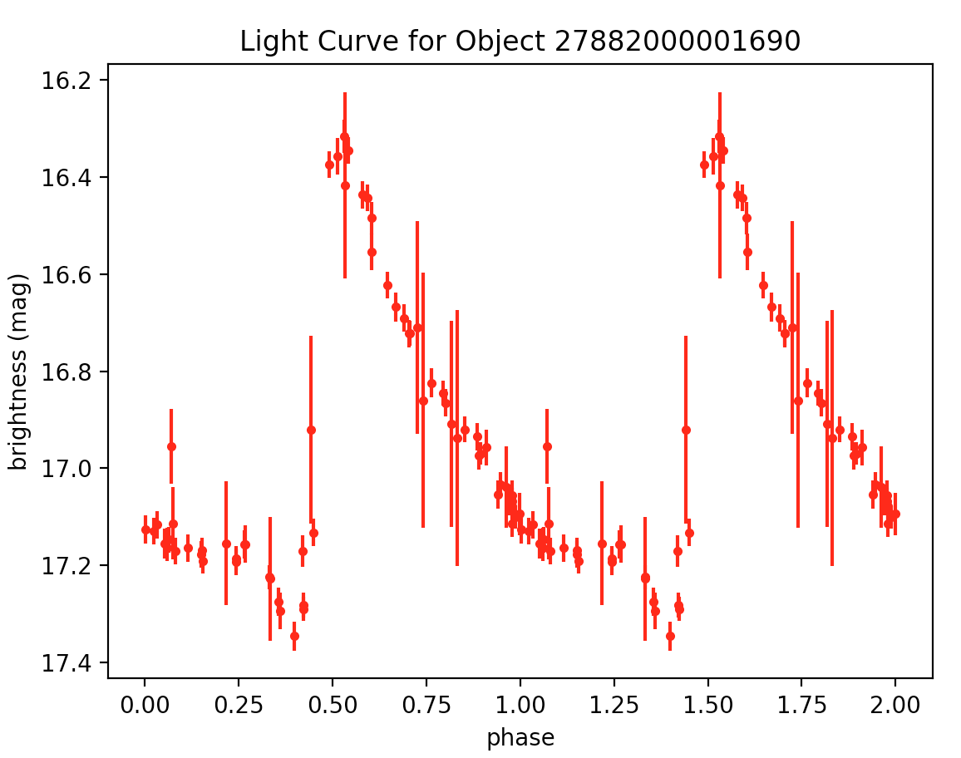
lyrae12.tbl – 20 50 01.9 +01 12 50 – period: 0.47739464735573495 – http://vizier.cfa.harvard.edu/viz-bin/VizieR-3?-source=J/MNRAS/398/1757/lyraes

Slide 64
lyrae4.tbl – 21 00 08.7 +00 27 02 – period: 0.4661441811921079 – http://vizier.cfa.harvard.edu/viz-bin/VizieR-3?-source=J/MNRAS/398/1757/lyraes

Slide 65
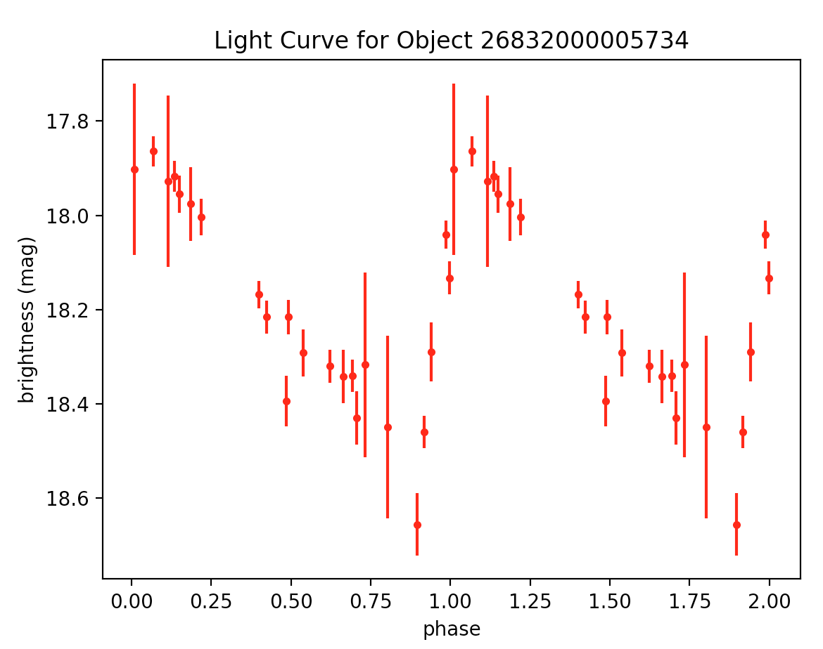
lyrae19.tbl – 20 50 00.9 -00 42 24 – period: 0.6271947897674425 – http://vizier.cfa.harvard.edu/viz-bin/VizieR-3?-source=J/MNRAS/398/1757/lyraes

Slide 66

lyrae23.tbl – 20 52 21.1 +00 08 01 – period: 0.5592960029351854 – http://vizier.cfa.harvard.edu/viz-bin/VizieR-3?-source=J/MNRAS/398/1757/lyraes

Slide 67

lyrae24.tbl – 20 52 41.8 +01 10 33 – period: 0.6333033991926649 – http://vizier.cfa.harvard.edu/viz-bin/VizieR-3?-source=J/MNRAS/398/1757/lyraes

Slide 68

lyrae26.tbl – 20 52 42.7 +00 46 31 – period: 0.6434066581007793 – http://vizier.cfa.harvard.edu/viz-bin/VizieR-3?-source=J/MNRAS/398/1757/lyraes

Slide 69

lyrae29.tbl – 20 54 11.7 -00 32 28 – period: 0.6424224981498232 – http://vizier.cfa.harvard.edu/viz-bin/VizieR-3?-source=J/MNRAS/398/1757/lyraes

Slide 70

lyrae33.tbl – 20 57 32.9 +00 11 52 – period: 0.6278003820793125 – http://vizier.cfa.harvard.edu/viz-bin/VizieR-3?-source=J/MNRAS/398/1757/lyraes

Slide 71

lyrae36.tbl – 20 58 28.8 +00 21 12 – period: 0.723389572049963 – http://vizier.cfa.harvard.edu/viz-bin/VizieR-3?-source=J/MNRAS/398/1757/lyraes

Slide 72

lyrae40.tbl – 21 00 08.7 +00 27 02 – period: 0.4661441811921079 – http://vizier.cfa.harvard.edu/viz-bin/VizieR-3?-source=J/MNRAS/398/1757/lyraes

Slide 73
Light Curves and .’s
The following are the light curves of various variable stars and the corresponding expected period range.
For the zooniverse project we will be showing these (the PTF messier-actual-data version) to our users (and superusers!)

Slide 74

“The periods of eclipsing variables are generally in the range of 0.25 to ten days because, as mentioned above, most eclipsing variables are likely to be close binaries. But some eclipsing variables -- especially those containing giant or supergiant components -- have periods as long as several decades” (Percy textbook).

Slide 75
RR Lyrae periods 0.1 - 1 day ; sinusoidal (RRc): mean period = 0.33 days with approximate range of 0.267 - 0.38 days ; asymmetric (RRab): mean period = 0.69 days with approximate range of 0.466 - 0.72 days

Slide 76

Cepheid Variables are the most important type of variable because it has been discovered that their periods of variability are related to their absolute luminosity. This makes them invaluable as a contributer to astronomical distance measurement. The periods are very regular and range from 1 to 100 days (Hyperphysics).
Cepheids with periods as short as 0.8 day (fundamental mode) and 0.5 day (first overtone) have recently been found in the dwarf irregular galaxies of the Local Group -- including the Magellanic Clouds -- thanks to large-scale photometric surveys -> poses problem (b/c similar shape to RRab)

Slide 77

Mira variables: pulsating red giants ; light curve roughly sinusoidal with slightly varying amplitude as shown above ; stable periods of 100 – 1000 days, with most between 150 and 450 days

Slide 78
Proceeding…
So we have golden examples of RRL ab and RRL c, but not yet type d.
Need to continue with new classes of sources (e.g., Mira variables, Cepheids, Eclipsing Binaries)
Include amplitude as summary stat
Need to create zooniverse project
Can initialize project and begin working on tutorial, for example

Slide 79
Week 5

Slide 80
Employ cesium to also spit out amplitude
See if reflective of what ‘eye-balling’ light curve yields
Summary stats -> (amplitude, period, notion of ‘fuzziness’)

Slide 81


Slide 82
General Findings / Take-aways:
amplitude = ~ 1/2(bottom points location - top points location) (*)
I trust the 'by hand' the most b/c this is exactly (*)
cesium_amplitude too high (zero counter-examples) and freq1_amplitude1 is too low (13/17 times [there are 17 unique oid's])
cesium freq1_amplitude1 very good for gold/avg RRc => use freq1_amplitude1 as amplitude summary statistic for RRc
Not as straight-forward for RRab b/c asymmetric whereas RRab is sinusoidal/symmetric
cesium freq1_amplitude1 is low for all RRab but...
1/2(amplitude + freq1_amplitude1) gives a very good estimate for RRab!
=> use 1/2(amplitude + freq1_amplitude1) as amplitude summary statistic for RRab

Slide 83
Miras
-> periods of 100 – 1000 days, with most between 150 and 450 days

Slide 84

But didn’t lead to any good mira light curves in ptf… (see questions)

Slide 85

mira1.tbl – 01 22 58.3 +12 52 06 – period: 85.2587603376247
LPV with light curve representative of miras but if period is correct, it can’t be

Slide 86

mira6.tbl – 00 32 22.6 +26 01 44 – period: 313.4796238244514 – Found at: http://vizier.cfa.harvard.edu/viz-bin/VizieR-3?-source=J/ApJS/227/6&-out.max=50&-out.form=HTML%20Table&-out.add=_r&-out.add=_RAJ,_DEJ&-sort=_r&-oc.form=sexa

Slide 87

mira8.tbl – 01 03 57.5 +20 11 46 – period: 96.24639076034649 – Found at: http://vizier.cfa.harvard.edu/viz-bin/VizieR-3?-source=J/ApJS/227/6&-out.max=50&-out.form=HTML%20Table&-out.add=_r&-out.add=_RAJ,_DEJ&-sort=_r&-oc.form=sexa

Slide 88

mira10.tbl – 02 16 07.1 +25 03 24 – period: 335.2329869259135 – Found at: http://vizier.cfa.harvard.edu/viz-bin/VizieR-3?-source=J/ApJS/227/6&-out.max=50&-out.form=HTML%20Table&-out.add=_r&-out.add=_RAJ,_DEJ&-sort=_r&-oc.form=sexa

Slide 89

mira18.tbl – 20 39 00.76 +00 55 57.9 – period: 267.379679144385 – Found at: http://vizier.cfa.harvard.edu/viz-bin/VizieR-3?-source=J/other/NewA/17.504&-out.max=50&-out.form=HTML%20Table&-out.add=_r&-out.add=_RAJ,_DEJ&-sort=_r&-oc.form=sexa

Slide 90

mira18.tbl – 20 39 00.76 +00 55 57.9 – period: 267.379679144385 – Found at: http://vizier.cfa.harvard.edu/viz-bin/VizieR-3?-source=J/other/NewA/17.504&-out.max=50&-out.form=HTML%20Table&-out.add=_r&-out.add=_RAJ,_DEJ&-sort=_r&-oc.form=sexa

Slide 91

mira24.tbl – 00 04 20.07 +40 06 35.8 – period: 132.27513227513228 – Found at: http://vizier.cfa.harvard.edu/viz-bin/VizieR-3?-source=J/BaltA/9/646&-out.max=50&-out.form=HTML%20Table&-out.add=_r&-out.add=_RAJ,_DEJ&-sort=_r&-oc.form=sexa

Slide 92

mira25.tbl – 00 32 22.73 +26 01 46.0 – period: 313.4796238244514 – Found at: http://vizier.cfa.harvard.edu/viz-bin/VizieR-3?-source=J/BaltA/9/646&-out.max=50&-out.form=HTML%20Table&-out.add=_r&-out.add=_RAJ,_DEJ&-sort=_r&-oc.form=sexa

Slide 93

mira30.tbl – 01 03 57.5 +20 11 46 010357+2011.7 – period: 96.24639076034649 – http://vizier.cfa.harvard.edu/viz-bin/VizieR?-source=J/ApJS/227/6

Slide 94

mira30.tbl (same guy, diff. oid) – 01 03 57.5 +20 11 46 010357+2011.7 – period: 96.24639076034649 – http://vizier.cfa.harvard.edu/viz-bin/VizieR?-source=J/ApJS/227/6

Slide 95

mira31.tbl – 00 22 23.1 +26 59 46 – period: 292.39766081871346 – Found at http://vizier.cfa.harvard.edu/viz-bin/VizieR?-source=J/ApJS/227/6

Slide 96

mira38.tbl – 01 15 29.8 +40 43 09 – period: 247.64735017335315 – Found at: http://vizier.cfa.harvard.edu/viz-bin/VizieR-3?-source=J/MNRAS/317/460/stars&-out.max=50&-out.form=HTML%20Table&-out.add=_r&-out.add=_RAJ,_DEJ&-sort=_r&-oc.form=sexa

Slide 97

mira40.tbl – 23 14 44.2 +40 47 39 – period: 209.4240837696335 – Found at: http://vizier.cfa.harvard.edu/viz-bin/VizieR-3?-source=J/MNRAS/317/460/stars&-out.max=50&-out.form=HTML%20Table&-out.add=_r&-out.add=_RAJ,_DEJ&-sort=_r&-oc.form=sexa

Slide 98

mira42.tbl – 00 05 06.0 +00 43 48 – period: 191.755 – http://vizier.cfa.harvard.edu/viz-bin/VizieR?-source=II/264

Slide 99

mira49.tbl – 15 27 47.3 +19 33 48 – period: 584.1121495327103 – http://iopscience.iop.org/article/10.1086/338647/pdf

Slide 100

mira50.tbl – 16 25 47.47 +18 53 32.9 – period: 375.234521575985 – http://iopscience.iop.org/article/10.1086/338647/pdf

Slide 101

mira63.tbl – 320.77419055 +00.83782056 – period: 226.75736961451247 – http://vizier.u-strasbg.fr/viz-bin/VizieR?-source=J/A+A/384/925&-to=3

Slide 102

mira64.tbl – 316.71325944 -01.36506611 – period: 869.5652173913044 – http://vizier.u-strasbg.fr/viz-bin/VizieR?-source=J/A+A/384/925&-to=3

Slide 103

mira68.tbl – 8.09472019 +26.02943021 – period: 313.4796238244514 – http://vizier.u-strasbg.fr/viz-bin/VizieR?-source=J/A+A/384/925&-to=3

Slide 104
Miras are tough…
Mira variables ARE harder than RRL (though this will be true for everything, RRL are the best studied variables in astronomy over the past 30 yr). There is also a special reason Mira variables are hard for PTF: Mira variables are intrinsically very bright. Most of the Mira variables in the Galaxy will be so bright that they cause the PTF detectors to saturate. So many Miras are missed by PTF. For now we are going to keep the dataset homogeneous and only work with PTF data, though we may decide to adjust that in the future.
Nervous about using sources that are very bright because PTF saturates around 13.5 or 14 mag.
Options to adjust
Southern PTF (see questions)
See next slide

Slide 105
Again: finding golden/average miras is more challenging than RR Lyraes.
To be a mira technically speaking: peak to peak amplitude (twice from cesium) for miras has to be greater than 2.5 magnitudes in V band (filter a little more red than g filter)
If we can’t find sufficiently ‘good’ ones, here is an alternative:
http://www.astronet.ru/db/varstars/msg/eid/PZP-14-0009
See L.Curve & Data!

Slide 106
Questions
? when multiple oid's ?
How do frequencies add? (RRd combo of fundamental and first overtone)
add like f = f1 + f2 or reciprocals?
Plan for what to work on for the next 10 days
next couple of things

Slide 107
Questions
Why didn’t variable star catalogue -> any miras? Even the non negative second numbers…
I know –numbers are bad, but some positive lead to no sources found as well
It found 18 02 29.44 -30 24 14.1 ?
looking at a lot of data => going to see a lot of weird things - will eventually start to notice patterns
Pattern for what missed ptf?
Two types of RA and DEC – how to convert?
23.04642 30.54967 -> what? (this is a mira)
the following link works for converting! - http://www.astrouw.edu.pl/~jskowron/ra-dec/?q=+23.04642+30.54967
the link the flexible converter not working for me

Slide 108
Week 6

Slide 109
Quick remark about amplitude…

Slide 111
Amplitude
If source is periodic and symmetric, freq1_amplitude1 is good
If periodic and asymmetric (e.g. RRab), ½(freq1_amplitude1 + amplitude) is good
But we are also attempting to classify non-periodic light curves and we don’t know up front if the source is periodic
Can have zooniverse user ‘eye-ball’ and report an approximate value

Slide 112
“The periods of eclipsing variables are generally in the range of 0.25 to ten days because, as mentioned above, most eclipsing variables are likely to be close binaries. But some eclipsing variables -- especially those containing giant or supergiant components -- have periods as long as several decades” (Percy textbook).

Slide 113
Best EB LCs…

Slide 114

eb152.tbl – 14 29 38.946 +05 46 21.44 – period: 0.3432616031003388 – http://vizier.cfa.harvard.edu/viz-bin/VizieR?-source=J/MNRAS/453/3474 (Binary properties from MECI, including 1558 LC from ASAS, 350 LC from NSVS, and 230 LC from LINEAR [2138 rows] – with T’=2T – use for poster

Slide 115

eb142.tbl – 12 53 45.732 +07 45 36.69 – period: 0.3443305628496246 – http://vizier.cfa.harvard.edu/viz-bin/VizieR?-source=J/MNRAS/453/3474 (Binary properties from MECI, including 1558 LC from ASAS, 350 LC from NSVS, and 230 LC from LINEAR [2138 rows]

Slide 116

eb142.tbl – 12 53 45.732 +07 45 36.69 – period: 0.6886611256992492 – http://vizier.cfa.harvard.edu/viz-bin/VizieR?-source=J/MNRAS/453/3474 (Binary properties from MECI, including 1558 LC from ASAS, 350 LC from NSVS, and 230 LC from LINEAR [2138 rows]

Slide 117

eb145.tbl – 13 03 12.100 +34 16 47.53 – period: 0.9702577198555481 – http://vizier.cfa.harvard.edu/viz-bin/VizieR?-source=J/MNRAS/453/3474 (Binary properties from MECI, including 1558 LC from ASAS, 350 LC from NSVS, and 230 LC from LINEAR [2138 rows]

Slide 118

eb110.tbl – 119.858231 +39.112766 – period: 0.2138885995451445 – http://vizier.u-strasbg.fr/viz-bin/VizieR?-source=J/AJ/146/101

Slide 119

eb110.tbl – 119.858231 +39.112766 – period: 0.427777199090289 – http://vizier.u-strasbg.fr/viz-bin/VizieR?-source=J/AJ/146/101 – with T’ = 2T

Slide 120

eb124.tbl – 120.541634 +43.337402 – period: 0.16472483539870822 – http://vizier.u-strasbg.fr/viz-bin/VizieR?-source=J/AJ/146/101

Slide 121

eb124.tbl – 120.541634 +43.337402 – period: 0.16472483539870822 – http://vizier.u-strasbg.fr/viz-bin/VizieR?-source=J/AJ/146/101

Slide 122

eb106.tbl – 117.369339 +49.340282 – period: 0.20141408802923563 – http://vizier.u-strasbg.fr/viz-bin/VizieR?-source=J/AJ/146/101

Slide 123

eb106.tbl – 117.369339 +49.340282 – period: 0.40282817605 – http://vizier.u-strasbg.fr/viz-bin/VizieR?-source=J/AJ/146/101 – with T’ = 2T

Slide 124

eb106.tbl – 117.369339 +49.340282 – period: 0.20141408802923563 – http://vizier.u-strasbg.fr/viz-bin/VizieR?-source=J/AJ/146/101

Slide 125

eb106.tbl – 117.369339 +49.340282 – period: 0.40282817605 – http://vizier.u-strasbg.fr/viz-bin/VizieR?-source=J/AJ/146/101 – with T’ = 2T

Slide 126

eb100.tbl – 17 35 32.388 +57 48 09.36 – period: 0.5876766556026741 – http://vizier.cfa.harvard.edu/viz-bin/VizieR-3

Slide 127
eb100.tbl – 17 35 32.388 +57 48 09.36 – period: 1.17535331121 – http://vizier.cfa.harvard.edu/viz-bin/VizieR-3 – with T’ = 2T

Slide 128

eb1.tbl – 00 44 29.272 +41 23 01.45 – period: 1.5844571095382733 – http://vizier.cfa.harvard.edu/viz-bin/VizieR-3?-source=J/MNRAS/362/1006&-out.max=50&-out.form=HTML%20Table&-out.add=_r&-out.add=_RAJ,_DEJ&-sort=_r&-oc.form=sexa – contact binary –> plot with T’=2T

Slide 129

eb1.tbl – 00 44 29.272 +41 23 01.45 – period: 3.16891421908 – http://vizier.cfa.harvard.edu/viz-bin/VizieR-3?-source=J/MNRAS/362/1006&-out.max=50&-out.form=HTML%20Table&-out.add=_r&-out.add=_RAJ,_DEJ&-sort=_r&-oc.form=sexa – contact binary –> plotted with T’=2T

Slide 130

eb96.tbl – 8:39:54.6 +19:49:18 – period: 1.09296246931 – http://var2.astro.cz/EN/brno/eclipsing_binaries.php?f=list&cons=Cnc – with T’=2T

Slide 131

eb96.tbl – 8:39:54.6 +19:49:18 – period: 0.5464812346541238 – http://var2.astro.cz/EN/brno/eclipsing_binaries.php?f=list&cons=Cnc – same thing -> try plotting T’ = 2T

Slide 132

eb96.tbl – 8:39:54.6 +19:49:18 – period: 1.09296246931 – http://var2.astro.cz/EN/brno/eclipsing_binaries.php?f=list&cons=Cnc – with T’ = 2T

Slide 133

eb96.tbl – 8:39:54.6 +19:49:18 – period: 0.5464812346541238 – http://var2.astro.cz/EN/brno/eclipsing_binaries.php?f=list&cons=Cnc – same thing -> try plotting T’ = 2T

Slide 134

eb96.tbl – 8:39:54.6 +19:49:18 – period: 1.09296246931 – http://var2.astro.cz/EN/brno/eclipsing_binaries.php?f=list&cons=Cnc – with T’ = 2T

Slide 135

eb96.tbl – 8:39:54.6 +19:49:18 – period: 0.5464812346541238 – http://var2.astro.cz/EN/brno/eclipsing_binaries.php?f=list&cons=Cnc – same thing -> try plotting T’ = 2T

Slide 136

eb10.tbl – 21:39:43 28:22:39 – period: 0.17631450840958496 – http://www.sciencedirect.com/science/article/pii/S1384107616301828?via%3Dihub – contact binary (chance it could be RRc)

Slide 137

eb96.tbl – 8:39:54.6 +19:49:18 – period: 0.5464812346541238 – http://var2.astro.cz/EN/brno/eclipsing_binaries.php?f=list&cons=Cnc – period is probably wrong b/c there shouldn't be points above eclipse

Slide 138

eb70.tbl – 15:8:9.2 +39:58:12.3 – period: 0.14863507665928397 – http://var2.astro.cz/EN/brno/eclipsing_binaries.php?f=list&cons=Boo – plot at twice the period -> should look nicer

Slide 139

eb70.tbl – 15:8:9.2 +39:58:12.3 – period: 0.29727015331 – http://var2.astro.cz/EN/brno/eclipsing_binaries.php?f=list&cons=Boo – plotted with twice the period

Slide 140

eb15.tbl – 12:51:21.37 27:13:46.7 – period: 0.13334190277295155 – http://www.sciencedirect.com/science/article/pii/S1384107616301828?via%3Dihub – looks like contact binary, saturation might be an issue

Slide 141

eb2.tbl – 00 44 48.675 +41 29 15.56 – period: 0.2606250988746469 – http://vizier.cfa.harvard.edu/viz-bin/VizieR-3?-source=J/MNRAS/362/1006&-out.max=50&-out.form=HTML%20Table&-out.add=_r&-out.add=_RAJ,_DEJ&-sort=_r&-oc.form=sexa – contact binary – BAD!

Slide 142

eb11.tbl – 01:42:29.33 44:45:42.4 – period: 0.25336256461695505 – http://www.sciencedirect.com/science/article/pii/S1384107616301828?via%3Dihub – contact binary – saturation issues!

Slide 143

eb158.tbl – 15 09 24.767 +13 46 00.83 – period: 0.3090320806202892 – http://vizier.cfa.harvard.edu/viz-bin/VizieR?-source=J/MNRAS/453/3474 (Binary properties from MECI, including 1558 LC from ASAS, 350 LC from NSVS, and 230 LC from LINEAR [2138 rows]

Slide 144

eb96.tbl – 8:39:54.6 +19:49:18 – period: 1.09296246931 – http://var2.astro.cz/EN/brno/eclipsing_binaries.php?f=list&cons=Cnc – plotted with T’ = 2T

Slide 145

eb96.tbl – 8:39:54.6 +19:49:18 – period: 0.5464812346541238 – http://var2.astro.cz/EN/brno/eclipsing_binaries.php?f=list&cons=Cnc – same thing -> try plotting T’ = 2T

Slide 146

eb96.tbl – 8:39:54.6 +19:49:18 – period: 1.09296246931 – http://var2.astro.cz/EN/brno/eclipsing_binaries.php?f=list&cons=Cnc – with T’ = 2T

Slide 147

eb15.tbl – 12:51:21.37 27:13:46.7 – period: 0.26668380554 – http://www.sciencedirect.com/science/article/pii/S1384107616301828?via%3Dihub – looks like contact binary, saturation might be an issue – plotted with T’=2T

Slide 148

eb95.tbl – 8:43:56.15 +19:2:3 – period: 2.37141590129 – http://var2.astro.cz/EN/brno/eclipsing_binaries.php?f=list&cons=Cnc – sat issue but looks like eb (ratty)

Slide 149

eb57.tbl – 2:46:14.1 +27:52:39 – period: 0.042339087229400836 – http://var2.astro.cz/EN/brno/eclipsing_binaries.php?f=list&cons=Ari – bad!

Slide 150

eb58.tbl – 2:15:20.8 +22:34:11 – period: 0.5131992275325227 – http://var2.astro.cz/EN/brno/eclipsing_binaries.php?f=list&cons=Ari – saturation issue!

Slide 151

eb81.tbl – 15:43:0.25 +43:15:55.1 – period: 3164.556962025317 – http://var2.astro.cz/EN/brno/eclipsing_binaries.php?f=list&cons=Boo – confident period is wrong => disregard

Slide 152

eb85.tbl – 20:27:8.49 -11:32:50.5 – period: 1.0750226023502145 – http://var2.astro.cz/EN/brno/eclipsing_binaries.php?f=list&cons=Cap – bad!

Slide 153

eb88.tbl – 20:24:29.7 -12:57:55 – period: 1.822110951980088 – http://var2.astro.cz/EN/brno/eclipsing_binaries.php?f=list&cons=Cap – bad!

Slide 154

eb94.tbl – 8:6:38.6 +1:55:46 – period: 0.5474247769928314 – http://var2.astro.cz/EN/brno/eclipsing_binaries.php?f=list&cons=CMi – bad!

Slide 155

eb148.tbl – 13 18 19.519 +66 39 28.71 – period: 0.327893148803813 – http://vizier.cfa.harvard.edu/viz-bin/VizieR?-source=J/MNRAS/453/3474 (Binary properties from MECI, including 1558 LC from ASAS, 350 LC from NSVS, and 230 LC from LINEAR [2138 rows]

Slide 156

use ga if want to use l and b?
Tried online converters….
Shouldn’t need to => just plug in as is to PTF (it can handle both coords)

Slide 157
Binary Classification / Types
roche lobe: used to describe a distinctively shaped region surrounding a star in a binary system. This teardrop-shaped space defines the region in which material is bound to the star by gravity. Any material outside the Roche-lobe of a star may, depending on its initial location, energy and momentum, either escape the system completely, orbit both stars, or fall onto the binary companion.
In detached binaries, both components are well within their Roche lobes.
In semi-detached binaries (SD in the GCVS4), one component fills its Roche lobe; the other is well within its Roche lobe. The former star is distorted, and is prob- ably losing mass through the inner Lagrangian point; the latter star is almost spherical (figure 5.4).
In contact binaries (K in the GCVS4), both components fill their Roche lobes, and are essentially in contact.

Slide 158
Period Ranges for EBs:
–– the farther apart the eclipsing binaries (i.e. the more detached it is, the longer the period) => detached binaries have the longest periods, then semi-detached, then contact binaries –– cut-offs?
The periods of eclipsing variables are generally in the range of 0.25 to ten days because, as mentioned above, most eclipsing variables are likely to be close binaries.
contact binaries period: 0 - ~10
semi-detached period: ~8 - ~16
detached periods: ~20 - infinity
how good is this? what modifications would make more robust?
Detached binary: There is no physical contact between the both stars. None has filled it's Roche lobe and they are both spherical in shape (unless one or both of them rotate really fast).
Semi-detached binary: One of the stars has filled its Roche lobe and has a shape which resembles an egg - due to the gravitational distortion of a very close neutron star or a black hole, which also rips gas from the surface of the distorted star. The gas often has a too high angular momentum while moving towards the compact object that the gas slowly forms an accretion disc.
Contact binary: In this case, both stars will have filled their Roche lobe, and may have become slightly egg-shaped. In this case the stars are relatively close to each other.
=> the shape of the light curve will be the telling difference?
I think in general detached binaries will have the longest periods, but semi-detached and contact binaries overlap?
Look at light curve character not period.

Slide 159

Distinguished by LC
Can tell what's going on EB type based off LC!
the size of the star relative to orbit determines period (not the type of EB)
two stars orbiting - they can evolve and become giants that both fill roche lobe so what started out as detached becomes semi-detached when the first giant fills roche lobe and can become contact binaries if they both fill roche lobe
even as this evolution is happening, the orbit stays approx. the same b/c the mass is pretty much invariant
detached => sharp dip in light curve
semi-detached => onset is more gradual, rounded between eclipses
contact binaries => look sinusoidal - you don't have the flat part outside of eclipse b/c they are 'touching’
To the right: detached binary light curves

Slide 160
Let’s find more good EB LCs…

Slide 161

eb148.tbl – 13 18 19.519 +66 39 28.71 – period: 0.327893148803813 – http://vizier.cfa.harvard.edu/viz-bin/VizieR?-source=J/MNRAS/453/3474 (Binary properties from MECI, including 1558 LC from ASAS, 350 LC from NSVS, and 230 LC from LINEAR [2138 rows] – with T’=2T

Slide 162

eb151.tbl – 14 30 12.451 -00 37 45.08 – period: 0.20028542676167807 – http://vizier.cfa.harvard.edu/viz-bin/VizieR?-source=J/MNRAS/453/3474 (Binary properties from MECI, including 1558 LC from ASAS, 350 LC from NSVS, and 230 LC from LINEAR [2138 rows] – with T’=2T

Slide 163

eb153.tbl – 14 38 38.591 +04 10 57.57 – period: 0.1029746651946095 – http://vizier.cfa.harvard.edu/viz-bin/VizieR?-source=J/MNRAS/453/3474 (Binary properties from MECI, including 1558 LC from ASAS, 350 LC from NSVS, and 230 LC from LINEAR [2138 rows] – with T’=2T

Slide 164

eb158.tbl – 15 09 24.767 +13 46 00.83 – period: 0.3090320806202892 – http://vizier.cfa.harvard.edu/viz-bin/VizieR?-source=J/MNRAS/453/3474 (Binary properties from MECI, including 1558 LC from ASAS, 350 LC from NSVS, and 230 LC from LINEAR [2138 rows]

Slide 165

eb63.tbl – 3:5:51.8 +28:34:4 – period: 0.03582776504 – http://var2.astro.cz/EN/brno/eclipsing_binaries.php?f=list&cons=Ari – bad!

Slide 166

eb83.tbl – 4:5:57.6 +76:53:12 – period: 0.06056084184415031 – http://var2.astro.cz/EN/brno/eclipsing_binaries.php?f=list&cons=Cam – disregard!

Slide 167
Questions
–– range 0.25 - 10 days good for EBs?
–– picture for the three types of EBs that adam and I found at meeting - I couldn't find again doing a quick google search
–– EB LC one dip? Is this possible and if so how?

Slide 168
Week 7

Slide 169

Quasars (AGN)

Slide 170

Quasars (AGN)

Slide 171
Quasar Question
Quasars live only in galaxies with supermassive black holes — black holes that contain billions of times the mass of the sun. Although light cannot escape from the black hole itself, some signals can break free around its edges. How? Why?
While some dust and gas fall into the black hole, other particles are accelerated away from it at near the speed of light. The particles stream away from the black hole in jets above and below it, transported by one of the most powerful particle accelerators in the universe.
By what mechanism are things emitted from black hole? If it gets within its roche lobe, so to speak, it is a goner, but if is just outside -> gravitational slingshot?
When a galaxy, star or gas is absorbed into a quasar in such a way, the result is a massive collision of matter that causes a gigantic explosive output of radiation energy and light. This great burst of energy results in a flare, which is a distinct characteristic of quasars. => collision (not gravitational slingshot)
magnetic environment forms twin jets of material – AGN => the mechanism is magnetic fields/environment?

Slide 172

quasar1.tbl – 00 00 00.972 +04 49 47.21 – http://vizier.cfa.harvard.edu/viz-bin/VizieR-3?-source=VII/270/dr10q&-out.max=50&-out.form=HTML%20Table&-out.add=_r&-out.add=_RAJ,_DEJ&-sort=_r&-oc.form=sexa – AVG

Slide 173

quasar3.tbl – 00 00 01.381 -01 19 30.05 – http://vizier.cfa.harvard.edu/viz-bin/VizieR-3?-source=VII/270/dr10q&-out.max=50&-out.form=HTML%20Table&-out.add=_r&-out.add=_RAJ,_DEJ&-sort=_r&-oc.form=sexa – BAD

Slide 174


quasar4.tbl – 00 00 01.936 -00 14 27.51 – http://vizier.cfa.harvard.edu/viz-bin/VizieR-3?-source=VII/270/dr10q&-out.max=50&-out.form=HTML%20Table&-out.add=_r&-out.add=_RAJ,_DEJ&-sort=_r&-oc.form=sexa – OKAY

Slide 175

quasar10.tbl – 00 00 07.060 +06 03 33.87 – http://vizier.cfa.harvard.edu/viz-bin/VizieR-3?-source=VII/270/dr10q&-out.max=50&-out.form=HTML%20Table&-out.add=_r&-out.add=_RAJ,_DEJ&-sort=_r&-oc.form=sexa – BAD

Slide 176

quasar13.tbl – 00 00 11.164 -01 44 34.16 – http://vizier.cfa.harvard.edu/viz-bin/VizieR-3?-source=VII/270/dr10q&-out.max=50&-out.form=HTML%20Table&-out.add=_r&-out.add=_RAJ,_DEJ&-sort=_r&-oc.form=sexa – bad (but if got rid of white space…)

Slide 177

quasar15.tbl – 00 00 12.600 -01 42 16.73 – http://vizier.cfa.harvard.edu/viz-bin/VizieR-3?-source=VII/270/dr10q&-out.max=50&-out.form=HTML%20Table&-out.add=_r&-out.add=_RAJ,_DEJ&-sort=_r&-oc.form=sexa – bad (but if got rid of white space)

Slide 178
Week 8

Slide 179
Best Quasars...

Slide 180

quasar60.tbl – 16 07 44.826 +18 46 48.26 – http://vizier.cfa.harvard.edu/viz-bin/VizieR-3?-source=VII/270/dr10q&-out.max=50&-out.form=HTML%20Table&-out.add=_r&-out.add=_RAJ,_DEJ&-sort=_r&-oc.form=sexa – GREAT

Slide 181

quasar11.tbl – 00 00 07.589 +00 29 43.27 – http://vizier.cfa.harvard.edu/viz-bin/VizieR-3?-source=VII/270/dr10q&-out.max=50&-out.form=HTML%20Table&-out.add=_r&-out.add=_RAJ,_DEJ&-sort=_r&-oc.form=sexa – great (mimics getting rid of white space)

Slide 182

quasar12.tbl – 00 00 09.278 +02 06 21.99 – http://vizier.cfa.harvard.edu/viz-bin/VizieR-3?-source=VII/270/dr10q&-out.max=50&-out.form=HTML%20Table&-out.add=_r&-out.add=_RAJ,_DEJ&-sort=_r&-oc.form=sexa – more random (not quite as good as last one)

Slide 183

quasar74.tbl – 16 19 02.497 +30 30 51.62 – http://vizier.cfa.harvard.edu/viz-bin/VizieR-3?-source=VII/270/dr10q&-out.max=50&-out.form=HTML%20Table&-out.add=_r&-out.add=_RAJ,_DEJ&-sort=_r&-oc.form=sexa

Slide 184

quasar74.tbl – 16 19 02.497 +30 30 51.62 – http://vizier.cfa.harvard.edu/viz-bin/VizieR-3?-source=VII/270/dr10q&-out.max=50&-out.form=HTML%20Table&-out.add=_r&-out.add=_RAJ,_DEJ&-sort=_r&-oc.form=sexa

Slide 185

quasar76.tbl – 16 04 41.472 +16 45 38.34 – http://vizier.cfa.harvard.edu/viz-bin/VizieR-3?-source=VII/270/dr10q&-out.max=50&-out.form=HTML%20Table&-out.add=_r&-out.add=_RAJ,_DEJ&-sort=_r&-oc.form=sexa

Slide 186


quasar51.tbl – 15 43 29.473 +33 59 08.71 – http://vizier.cfa.harvard.edu/viz-bin/VizieR-3?-source=VII/270/dr10q&-out.max=50&-out.form=HTML%20Table&-out.add=_r&-out.add=_RAJ,_DEJ&-sort=_r&-oc.form=sexa

Slide 187
Others…

Slide 188

quasar74.tbl – 16 19 02.497 +30 30 51.62 – http://vizier.cfa.harvard.edu/viz-bin/VizieR-3?-source=VII/270/dr10q&-out.max=50&-out.form=HTML%20Table&-out.add=_r&-out.add=_RAJ,_DEJ&-sort=_r&-oc.form=sexa

Slide 189

quasar30.tbl – 13 33 35.785 +16 49 03.96 – http://vizier.cfa.harvard.edu/viz-bin/VizieR-3?-source=VII/270/dr10q&-out.max=50&-out.form=HTML%20Table&-out.add=_r&-out.add=_RAJ,_DEJ&-sort=_r&-oc.form=sexa

Slide 190


quasar36.tbl – 14 23 26.054 +32 52 20.37 – http://vizier.cfa.harvard.edu/viz-bin/VizieR-3?-source=VII/270/dr10q&-out.max=50&-out.form=HTML%20Table&-out.add=_r&-out.add=_RAJ,_DEJ&-sort=_r&-oc.form=sexa

Slide 191

quasar38.tbl – 07 45 21.785 +47 34 36.44 – http://vizier.cfa.harvard.edu/viz-bin/VizieR-3?-source=VII/270/dr10q&-out.max=50&-out.form=HTML%20Table&-out.add=_r&-out.add=_RAJ,_DEJ&-sort=_r&-oc.form=sexa

Slide 192


quasar50.tbl – 12 38 20.198 +17 50 39.15 – http://vizier.cfa.harvard.edu/viz-bin/VizieR-3?-source=VII/270/dr10q&-out.max=50&-out.form=HTML%20Table&-out.add=_r&-out.add=_RAJ,_DEJ&-sort=_r&-oc.form=sexa

Slide 193

quasar53.tbl – 15 49 43.330 +21 14 03.39 – http://vizier.cfa.harvard.edu/viz-bin/VizieR-3?-source=VII/270/dr10q&-out.max=50&-out.form=HTML%20Table&-out.add=_r&-out.add=_RAJ,_DEJ&-sort=_r&-oc.form=sexa

Slide 194

quasar53.tbl – 15 49 43.330 +21 14 03.39 – http://vizier.cfa.harvard.edu/viz-bin/VizieR-3?-source=VII/270/dr10q&-out.max=50&-out.form=HTML%20Table&-out.add=_r&-out.add=_RAJ,_DEJ&-sort=_r&-oc.form=sexa

Slide 195

quasar53.tbl – 15 49 43.330 +21 14 03.39 – http://vizier.cfa.harvard.edu/viz-bin/VizieR-3?-source=VII/270/dr10q&-out.max=50&-out.form=HTML%20Table&-out.add=_r&-out.add=_RAJ,_DEJ&-sort=_r&-oc.form=sexa

Slide 196

quasar62.tbl – 22 15 11.934 -00 45 50.02 – http://vizier.cfa.harvard.edu/viz-bin/VizieR-3?-source=VII/270/dr10q&-out.max=50&-out.form=HTML%20Table&-out.add=_r&-out.add=_RAJ,_DEJ&-sort=_r&-oc.form=sexa

Slide 197

quasar62.tbl – 22 15 11.934 -00 45 50.02 – http://vizier.cfa.harvard.edu/viz-bin/VizieR-3?-source=VII/270/dr10q&-out.max=50&-out.form=HTML%20Table&-out.add=_r&-out.add=_RAJ,_DEJ&-sort=_r&-oc.form=sexa

Slide 198

quasar70.tbl – 14 25 01.461 +38 21 00.53 – http://vizier.cfa.harvard.edu/viz-bin/VizieR-3?-source=VII/270/dr10q&-out.max=50&-out.form=HTML%20Table&-out.add=_r&-out.add=_RAJ,_DEJ&-sort=_r&-oc.form=sexa

Slide 199

quasar73.tbl – 12 36 38.282 +03 02 50.36 – http://vizier.cfa.harvard.edu/viz-bin/VizieR-3?-source=VII/270/dr10q&-out.max=50&-out.form=HTML%20Table&-out.add=_r&-out.add=_RAJ,_DEJ&-sort=_r&-oc.form=sexa

Slide 200

quasar76.tbl – 16 04 41.472 +16 45 38.34 – http://vizier.cfa.harvard.edu/viz-bin/VizieR-3?-source=VII/270/dr10q&-out.max=50&-out.form=HTML%20Table&-out.add=_r&-out.add=_RAJ,_DEJ&-sort=_r&-oc.form=sexa

Slide 201

quasar80.tbl – 13 07 53.478 +11 58 03.34 – http://vizier.cfa.harvard.edu/viz-bin/VizieR-3?-source=VII/270/dr10q&-out.max=50&-out.form=HTML%20Table&-out.add=_r&-out.add=_RAJ,_DEJ&-sort=_r&-oc.form=sexa

Slide 202

quasar80.tbl – 13 07 53.478 +11 58 03.34 – http://vizier.cfa.harvard.edu/viz-bin/VizieR-3?-source=VII/270/dr10q&-out.max=50&-out.form=HTML%20Table&-out.add=_r&-out.add=_RAJ,_DEJ&-sort=_r&-oc.form=sexa

